Slide 1

LGB Robotic Automation Projects

Slide 2
PROJECT OVERVIEW
S.No | Project | Process Scope | Robots / Cobots | Start Date | End Date | Current Status
1 | Stellantis line 1-Phase | OP10 , Ultrasonic washing , Vision , OilWashing | 2 × UR12e Cobots | 07-07-2025 | 20-07-2026 | Installation & commissioning inprogress
2 | BMW RAD Line | OP10 → OP20→OP30→OP40 | 4 Cobots + 1 AMR | 02-02-2026 | 20-09-2026 | DAP Inprogress
3 | Helical Line | OP10 → OP20 | 2 UR12e Cobot + 1 yaskava 20kg robot | 31-03-2026 | 20-09-2026 | DAP Inprogress
4 | Ather Line | OP10 → OP20 | 5 × ABB 12kg Cobots | 15-02-2026 | 15-10-2026 | LOE given to vendor
5 | Daimler Line | OP10 → OP20 | 4 × UR12e Cobots | 24-04-2026 | 15-10-2026 | LOE given to vendor
LGB l Operations Technology

Slide 3
01
Stellantis Line

Slide 4
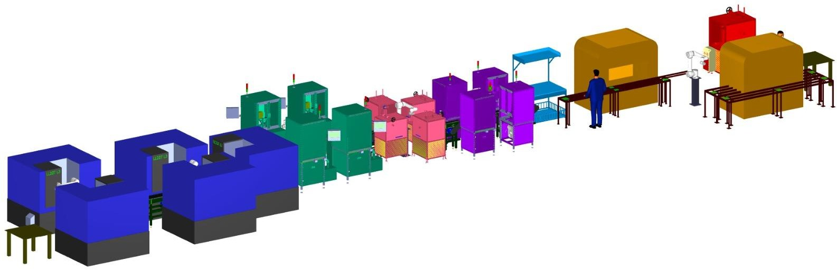
STELLANTIS LINE
3D Isometric Layout
Complete Stellantis Sprocket Automation Line — Turning to Packing
LGB l Operations Technology

Slide 5
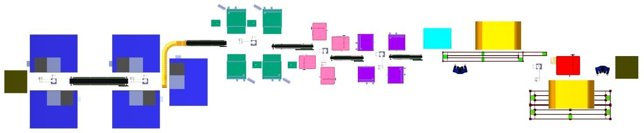
STELLANTIS LINE
Pick and Place Automation Topview
Part No. 1018
36400 mm
Phase 1 – Encircled with
Phase 2 – Encircled with
LGB l Operations Technology

Slide 6
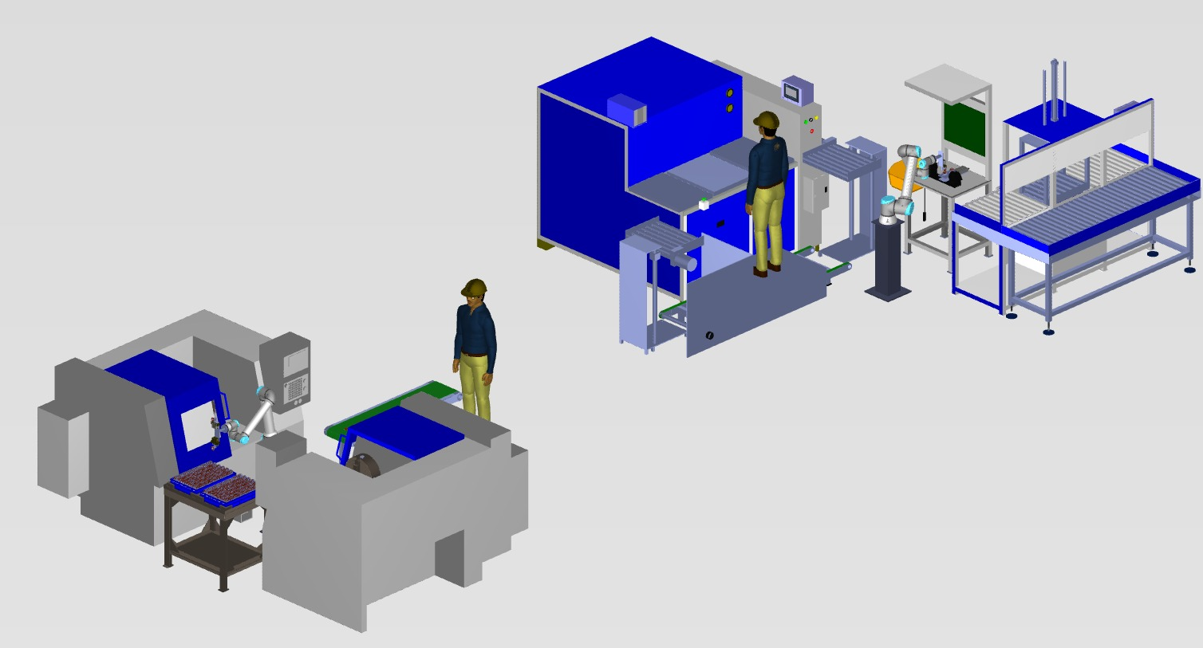
STELLANTIS LINE 1 - PHASE
1 Phase Layout Details
ULTRASONIC & INSPECTION MACHINE OPERATION
OP10 MACHINE OPERATION
LGB l Operations Technology

Slide 7
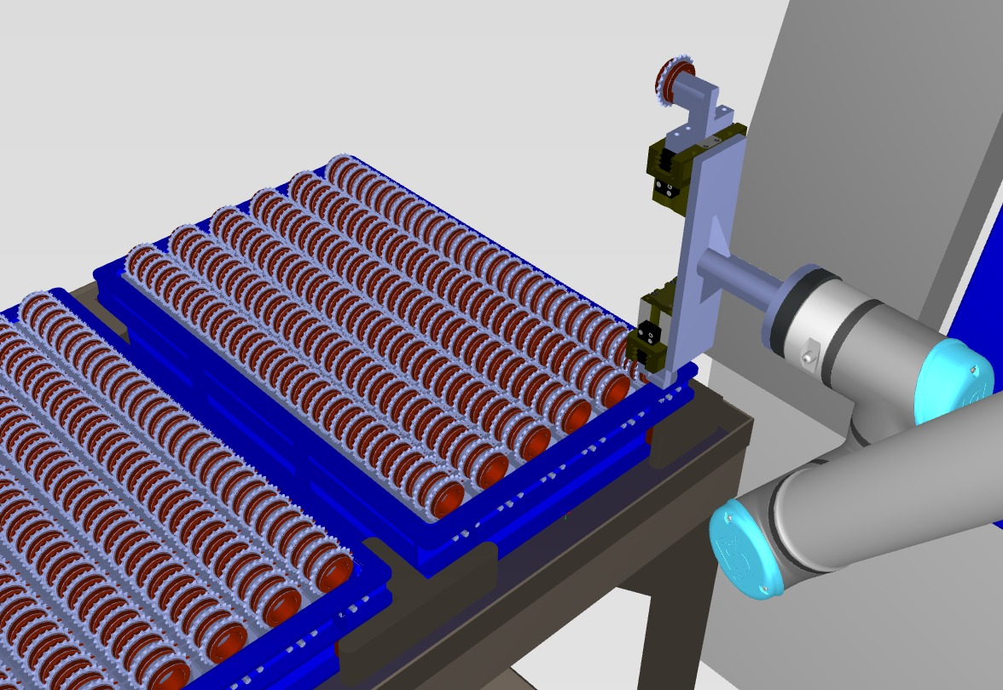
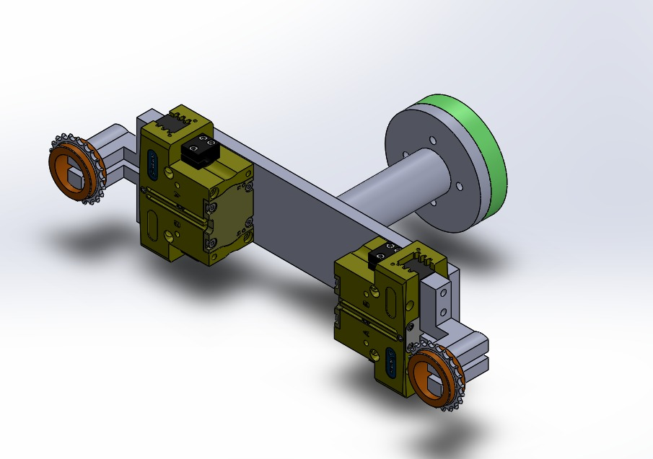
STELLANTIS LINE 1 - PHASE
OP10 INPUT TRAY
OP10 DUALGRIPPER
LGB l Operations Technology

Slide 8
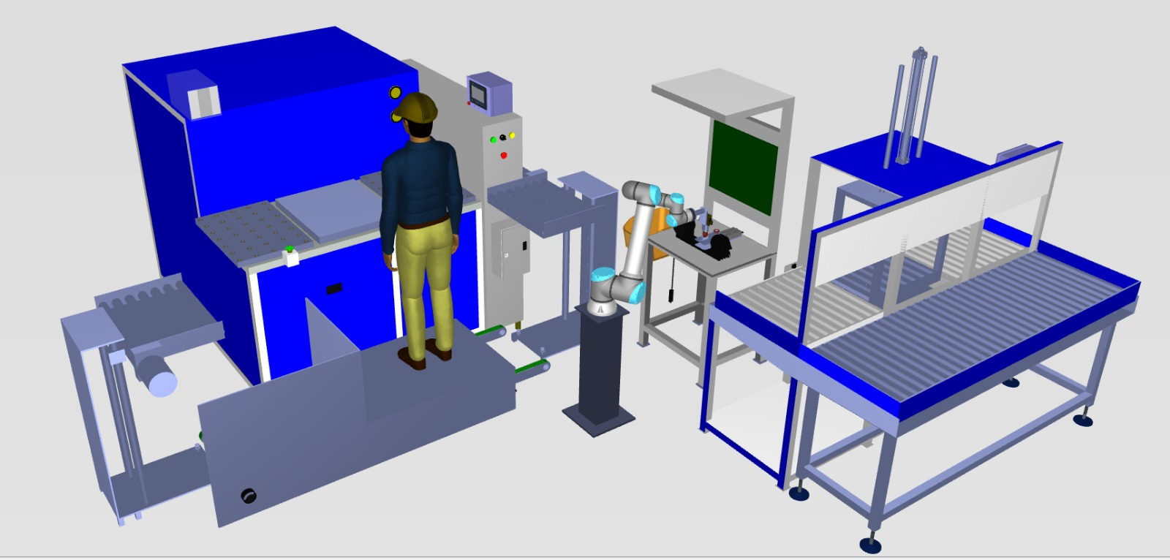
STELLANTIS LINE 1 - PHASE
Ultrasonic & Inspection Scanner & Oil Wash Machine
1
1
Ultrasonic Wash
3
4
2
UR 12e
2
3
Inspection Scanner Unit
4
Oil Wash Unit
LGB l Operations Technology

Slide 9
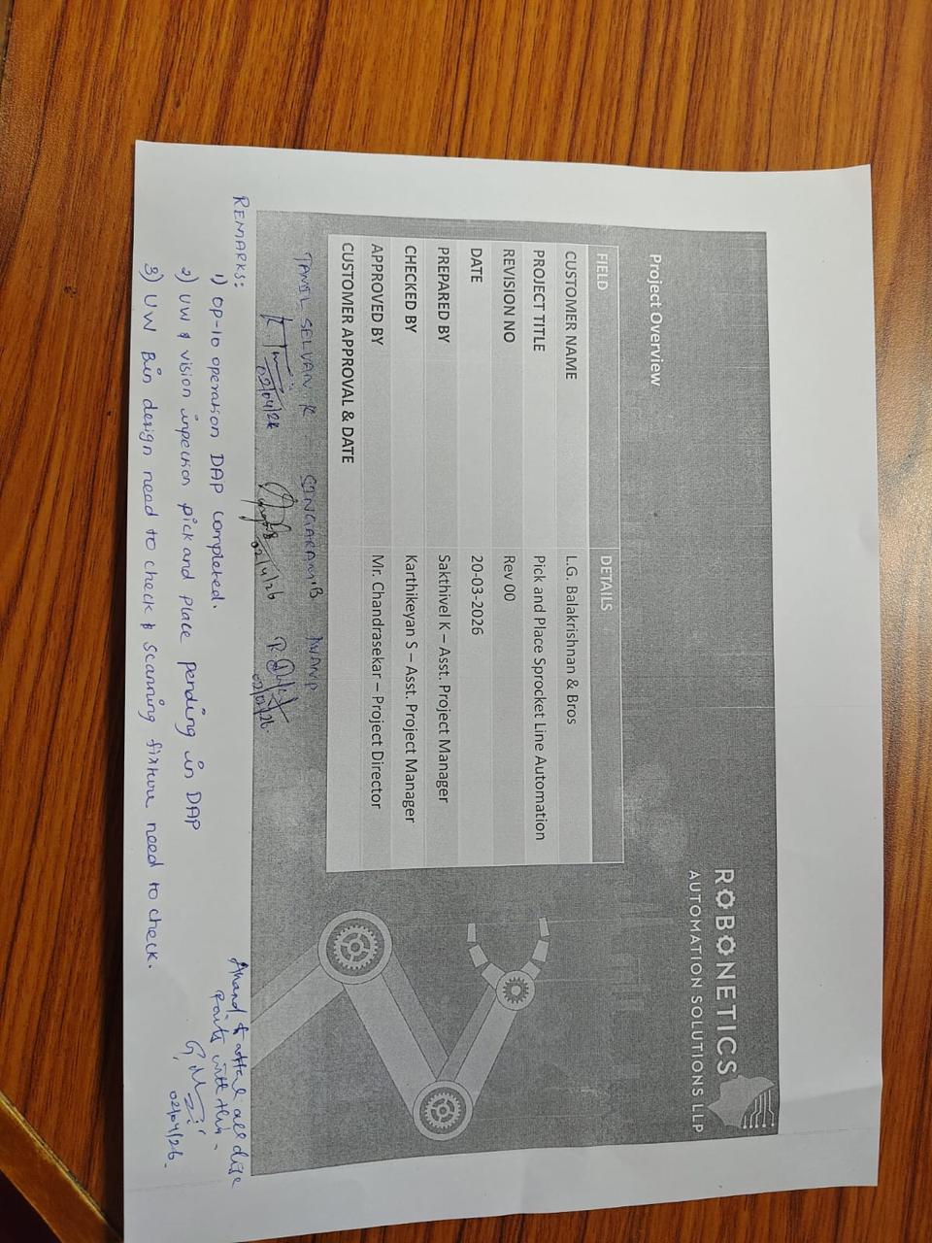
STELLANTIS LINE 1 - PHASE DAP APPROVAL (02-Apr-2026)
LGB l Operations Technology

Slide 10
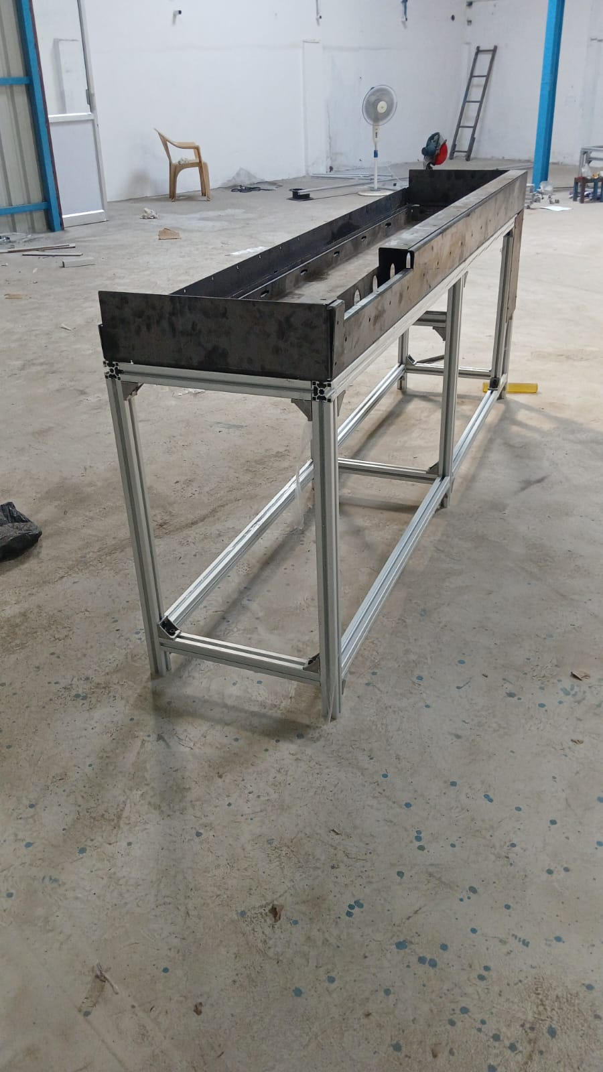
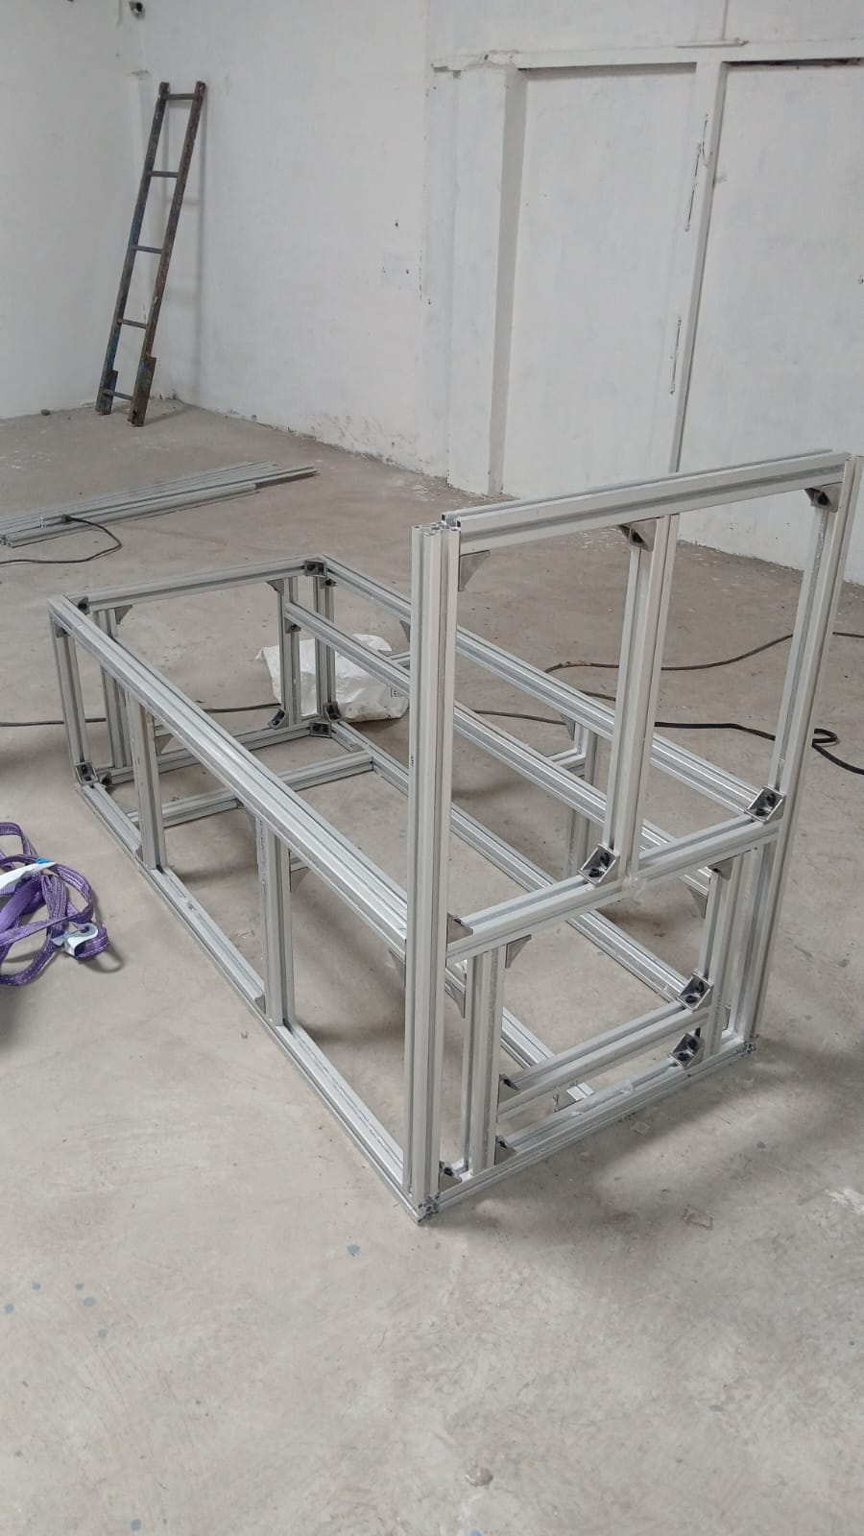
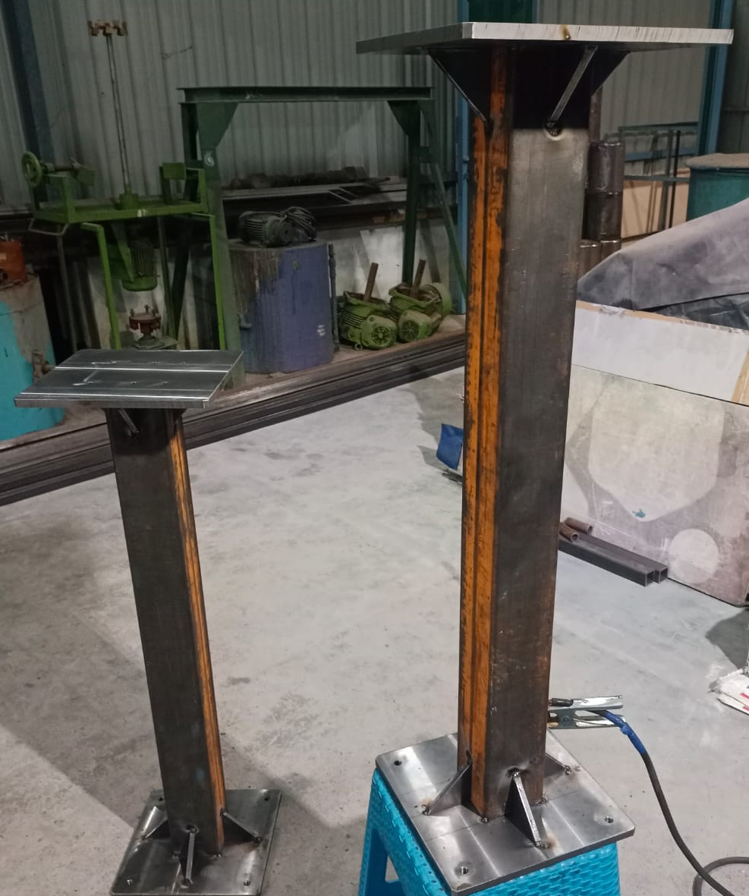
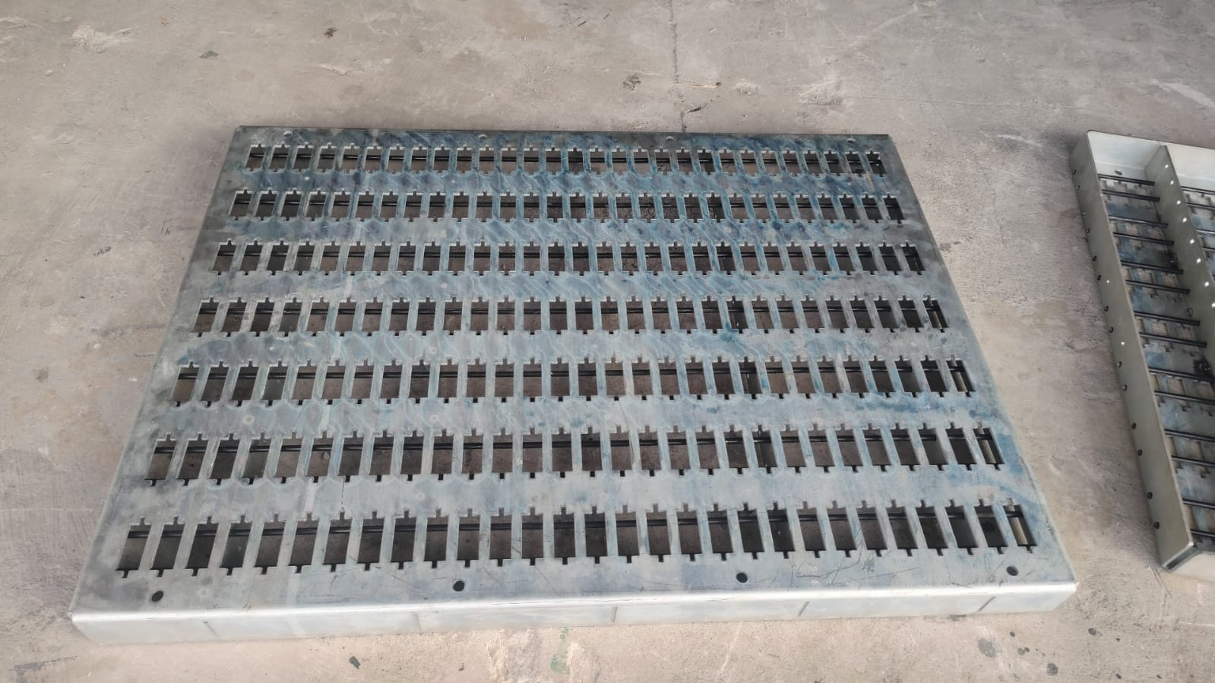
STELLANTIS LINE 1 - PHASE OP10 ISSUE TRACKER
LGB l Operations Technology

Slide 11
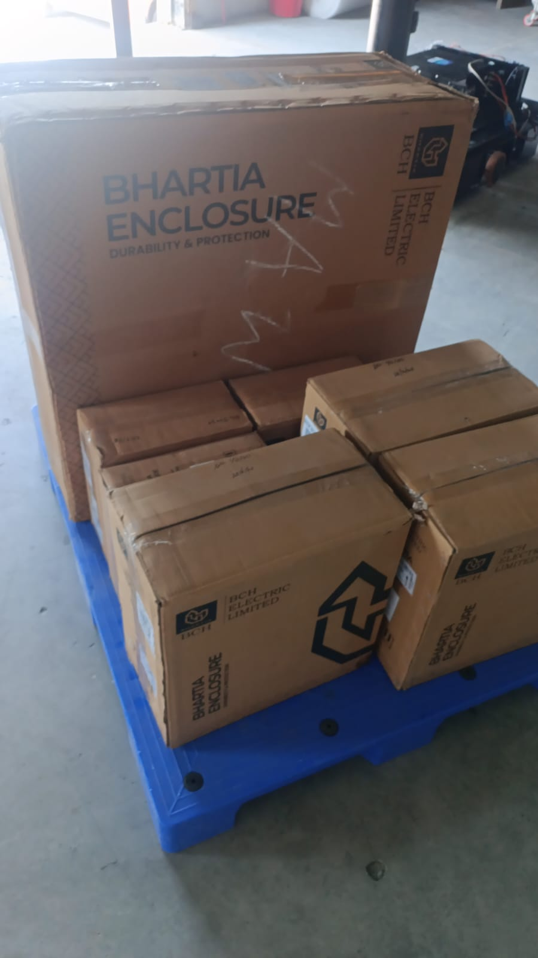
STELLANTIS LINE 1 - PHASE Electrical panel manafacturing
LGB l Operations Technology

Slide 12
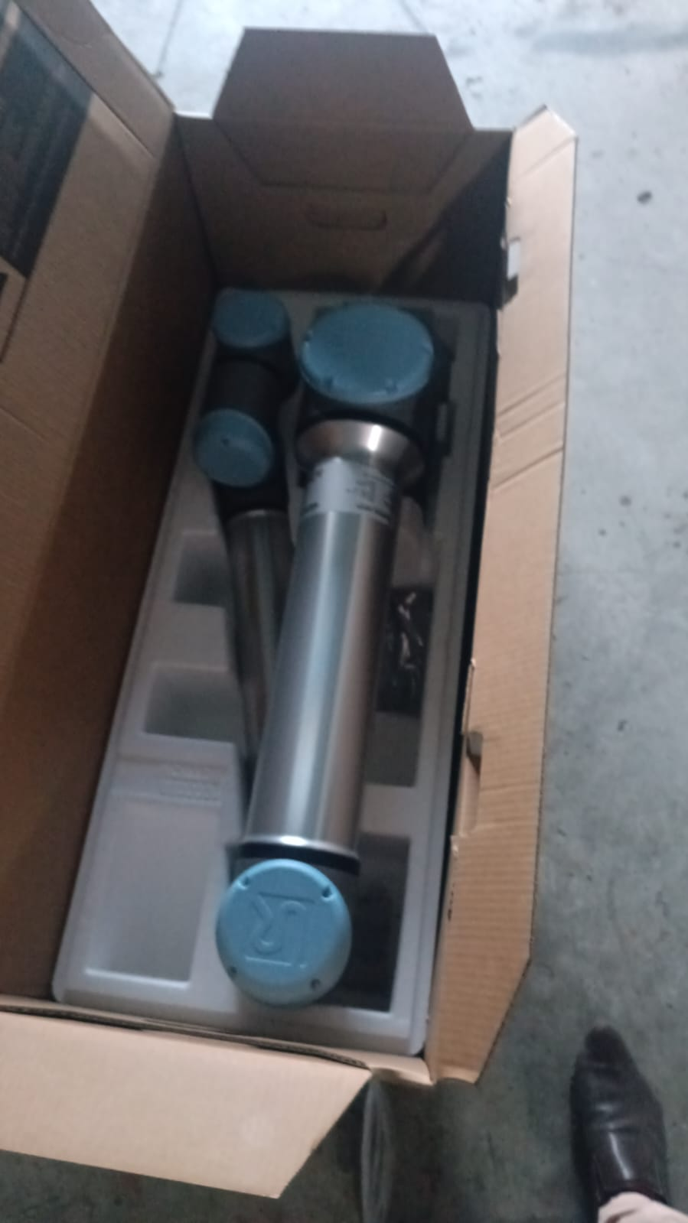
STELLANTIS LINE 1 - PHASE OP10 ISSUE TRACKER
LGB l Operations Technology

Slide 13
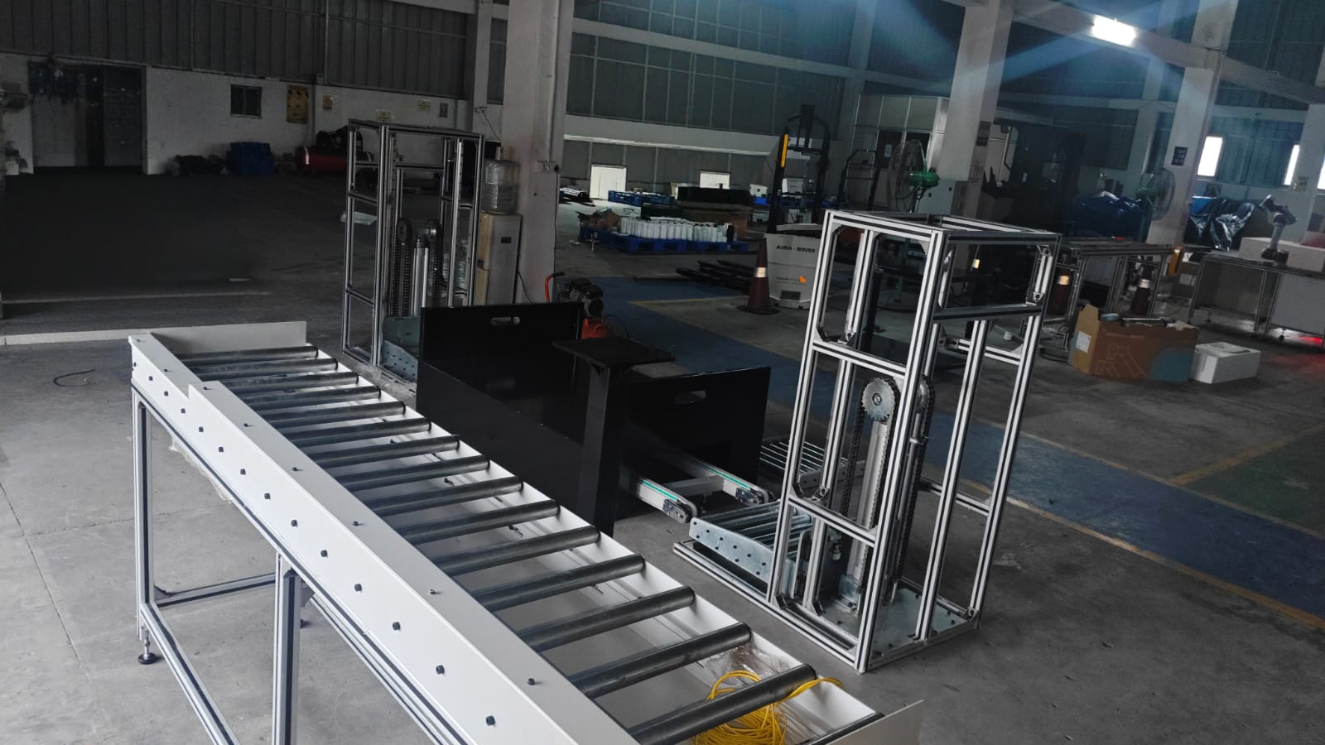
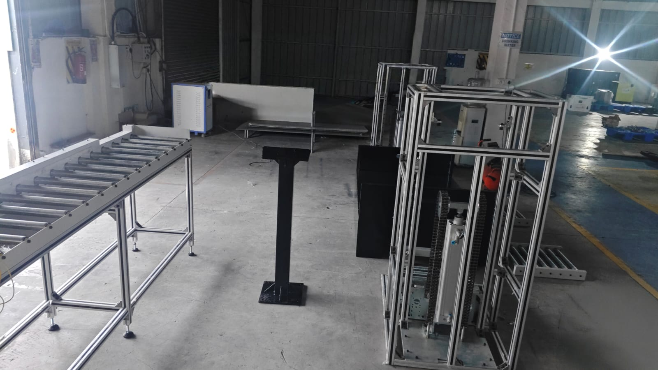
STELLANTIS LINE 1 - PHASE OP10 ISSUE TRACKER
LGB l Operations Technology

Slide 14
STELLANTIS LINE 1 - PHASE - FAT
LGB l Operations Technology

Slide 15
STELLANTIS LINE 1 - PHASE cobot delivary
LGB l Operations Technology

Slide 16
STELLANTIS LINE 1 - PHASE machien assemble
LGB l Operations Technology

Slide 17
STELLANTIS LINE 1 - PHASE
OP10 PRODUCTION VIDEO
LGB l Operations Technology

Slide 18
STELLANTIS LINE 1 - PHASE
OP10 PROJECT – CNC1 & CNC2 PART COUNT REPORT
Period: 14/08/2026 to 23/08/2026
Operation: OP10
Shift: 3 Shifts
Date | DAY | Shift | CNC1 Part Count | CNC2 Part Count | Total Part Count | Target Count | Actual count | Remarks
14/08/2026 | FRIDAY | 1st | 688 | 686 | 1374 | 3500 | 3709
 |  | 2nd | 731 | 709 | 1440
 |  | 3rd | 451 | 444 | 895
15/08/2026 | SATURDAY | HOLIDAY
16/08/2026 | SUNDAY | 1st | 596 | 575 | 1171 | 3500 | 1171 | Sunday 1 shift Running
 |  | 2nd | 0 | 0 | 0
 |  | 3rd | 0 | 0 | 0
17/08/2026 | MONDAY | 1st | 627 | 625 | 1252 | 3500 | 3311 | Finger Issue & Door Issue
 |  | 2nd | 492 | 470 | 962
 |  | 3rd | 562 | 535 | 1097
18/08/2026 | TUESDAY | 1st | 667 | 677 | 1344 | 3500 | 3730
 |  | 2nd | 659 | 654 | 1313
 |  | 3rd | 537 | 536 | 1073
19/08/2026 | WEDNESDAY | 1st | 701 | 627 | 1328 | 3500 | 3664
 |  | 2nd | 677 | 659 | 1336
 |  | 3rd | 500 | 500 | 1000
20/08/2026 | THURSDAY | 1st | 704 | 705 | 1409 | 3500 | 3217 | 3rd Shift CNC1 Not Running
 |  | 2nd | 660 | 635 | 1295
 |  | 3rd | 0 | 513 | 513
21/08/2026 | FRIDAY | 1st | 634 | 626 | 1260 | 3500 | 3528
 |  | 2nd | 651 | 650 | 1301
 |  | 3rd | 487 | 480 | 967
22/08/2026 | SATURDAY | 1st | 694 | 591 | 1285 | 3500 | 2472 | 3rd Shift CNC1 & 2 Not Running
 |  | 2nd | 591 | 596 | 1187
 |  | 3rd | 0 | 0 | 0
23/08/2026 | SUNDAY | 1st | 680 | 682 | 1362 | 3500 | 1362 | Sunday 1 shift Running
 |  | 2nd | 0 | 0 | 0
 |  | 3rd | 0 | 0 | 0
LGB l Operations Technology

Slide 19
STELLANTIS LINE 1 - PHASE UW
LGB l Operations Technology

Slide 20
STELLANTIS LINE 1 - PHASE
STELLANTIS LINE 1 - PHASE TRACKER
S No. | Task Description | Planned Date | Actual Date | Status
1 | Requirement Date & Initial Feasibility | 30-Jun-25 | 30-Jun-25 | Closed
2 | Plant Input & Cycle Time Study | 03-Jul-25 | 10-Jul-25 | Closed
3 | Budgetary Estimation & RFQ | 25-Jul-25 | 20-Aug-25 | Closed
4 | Vendor Pre-Qualification & NDA | 09-Aug-25 | 04-Sep-25 | Closed
5 | RFQ Submission & Tech Discussion | 11-Aug-25 | 11-Sep-25 | Closed
6 | Vendor Site Evaluation | 10-Sep-25 | 05-Oct-25 | Closed
7 | Offer Evaluation & Tech Compliance | 15-Sep-25 | 18-Oct-25 | Closed
8 | Risk Assessment & Commercial Negotiation | 02-Oct-25 | 06-Dec-25 | Closed
9 | Techno-Commercial Comparison | 08-Oct-25 | 30-Jan-26 | Closed
10 | Vendor Finalization & Mgmt Approval | 12-Oct-25 | 16-Feb-26 | Closed
11 | Scope Freeze & PO Release | 02-Nov-25 | 21-Mar-26 | Closed
12 | Advance Payment & Design Kick-off | 30-Mar-26 | 03-Apr-26 | Closed
13 | Design Approval (Robotic + Gripper + Conveyor) | 15-Mar-26 | 04-Apr-26 | Closed
14 | Cobot Delivery | 17-Mar-26 | 15-May-26 | Closed
15 | Mechanical Fabrication (All Sub-systems) | 20-Mar-26 | 20-May-26 | Closed
16 | Electrical / Controls Build | 30-Mar-26 | 20-May-26 | Closed
17 | FAT | 25-May-26 | 05-Jun-26 | Closed
18 | Dispatch | 07-Jun-26 | 19-Jun-26 | Closed
19 | Installation & Commissioning | 13-Jun-26 | 23-Jul-26 | Closed
LGB l Operations Technology

Slide 21
STELLANTIS LINE 1 - PHASE
STELLANTIS LINE 1 - PHASE INSTALLATION TRACKER
S.No | Activity | Responsible | Start Date | Target Date | Duration | Status | Remarks
1 | Material Receipt at Customer Site | RNT + Customer | 22-06-2026 | 23-06-2026 | 2 | CLOSED | Verify delivered materials
2 | Unloading & Inspection | RNT | 23-06-2026 | 23-06-2026 | 1 | CLOSED | Check for transit damage
3 | Machine Positioning & Alignment | RNT Mechanical Team | 24-06-2026 | 25-06-2026 | 2 | CLOSED | As per approved layout
4 | Conveyor and Lifter Installation & Leveling | RNT Mechanical Team | 25-06-2026 | 25-06-2026 | 1 | CLOSED | Alignment and leveling
5 | Cobot Pedestal Installation | RNT Mechanical Team | 25-06-2026 | 25-06-2026 | 1 | CLOSED | Anchor and level
6 | Cobot Installation | RNT Automation Team | 26-06-2026 | 26-06-2026 | 1 | CLOSED | Robot mounting
7 | Gripper Installation | RNT Automation Team | 26-06-2026 | 26-06-2026 | 1 | CLOSED | Mechanical & pneumatic connections
8 | Pneumatic Line Installation | RNT Mechanical Team | 26-06-2026 | 26-06-2026 | 1 | CLOSED | FRL, tubing, valves
9 | Control Panel Installation | RNT Electrical Team | 27-06-2026 | 01-07-2026 | 4 | CLOSED | Panel mounting
10 | Electrical Wiring & Cable Dressing | RNT Electrical Team | 27-06-2026 | 01-07-2026 | 4 | CLOSED | Power and I/O wiring
11 | PLC, HMI & Network Connections | RNT Automation Team | 02-07-2026 | 06-07-2026 | 4 | CLOSED | Communication setup
12 | Power ON & I/O Verification | RNT Automation Team | 07-07-2026 | 08-07-2026 | 2 | CLOSED | Sensor and actuator checks
13 | Robot Calibration | RNT Robot Engineer | 09-07-2026 | 09-07-2026 | 1 | CLOSED | TCP and frame calibration
14 | PLC & Robot Program | RNT Automation Team | 10-07-2026 | 11-07-2026 | 2 | CLOSED
15 | Dry Run Trial | RNT Automation Team | 13-07-2026 | 15-07-2026 | 3 | CLOSED | Without production parts
16 | Production Trial | RNT + Customer | 16-07-2026 | 18-07-2026 | 3 | CLOSED | Actual component validation
17 | Cycle Time Optimization | RNT Automation Team | 20-07-2026 | 21-07-2026 | 2 | CLOSED | Performance tuning
18 | Safety Validation | RNT + Customer | 22-07-2026 | 22-07-2026 | 1 | CLOSED | Safety interlocks and E-stop testing
19 | Operator & Maintenance Training | RNT | 23-07-2026 | 23-07-2026 | 1 | CLOSED | Customer training
20 | Site Acceptance Test (SAT) & Handover | RNT + Customer | 31-07-2026 | 15-08-2026 | 2 | CLOSED | Final approval
LGB l Operations Technology

Slide 22
STELLANTIS LINE 1 - PHASE OP10 ISSUE TRACKER
LGB l Operations Technology

Slide 23
STELLANTIS LINE 1 - PHASE
LGB l Operations Technology

Slide 24
PROJECT BOM - STELLANTIS LINE 1 PHASE
BOM | UOM | QTY | UNIT COST | TOTAL COST
Design & Engineering
PLC Program | Lot | 1 | 100000 | 100000
Project Management | Lot | 1 | 50000 | 50000
Drawing and Documentation | Lot | 1 | 30000 | 30000
Robots
Collaborative Robots | Nos | 2 | 1200000 | 1200000
Gripper
Robots | Nos | 7 | 100000 | 700000
Packing | Nos | 3 | 150000 | 450000
Mechanical Accessories
Pedestal | Nos | 7 | 20000 | 140000
Belt conveyor | Lot | 1 | 800000 | 800000
E&I
HMI | Lot | 1 | 200000 | 200000
Control Panel | Lot | 1 | 500000 | 500000
Teach Pendant | Lot | 1 | 200000 | 200000
Installation & Commissioning | Lot | 1 | 300000 | 300000
Digitalization | Lot | 1 | 300000 | 300000
TOTAL |  |  |  | ₹62,00,000
LGB l Operations Technology

Slide 25
NO OF MANPOWER REDUCED - STELLANTIS LINE 1 PHASE
Manpower Reduction -- Stellantis Line 1 Phase Automation
S.No | Station / Operation | Manpower / Per shift (Before) | Manpower / Per shift (After Automation) | Manpower Reduced / Per shift | Avg. Monthly Cost per Head (₹) / Per shift | Monthly Cost Savings (₹) / Per shift
1 | OP10 Machine Operation | 2 | 1 | 1 | ₹22,000 x 1 | ₹22,000
2 | Ultrasonic Wash, Vision & Oil Washing Station | 3 | 1 | 2 | ₹22,000 x 2 | ₹44,000
TOTAL MANPOWER PER SHIFT |  | 5 | 2 | 3 |  | ₹66,000
Summary
Total Manpower Before (Manual)/ Per shift | 5
Total Manpower After (Automation) / Per shift | 2
Total Manpower Reduced / Per shift | 3
% Manpower Reduction / Per shift | 60.0%
Total Monthly Cost Savings / Per shift | ₹66,000
Total Annual Cost Savings / Per shift | ₹7,92,000
LGB l Operations Technology

Slide 26
ROI CALCULATION - STELLANTIS LINE 1 PHASE
Parameter | Calculation | Value
Total Machines Automated |  | 5
Total Cobots Used |  | 2
Operators Required per Shift (Current) |  | 5
Total Shifts per Day |  | 3
Total Operators Required per Day (Current) | 5 × 3 | 15
Salary per Operator per Month |  | ₹ 22,000
Current Monthly Manpower Cost | 15 × 22,000 | ₹ 3,30,000
Current Annual Manpower Cost | 3,30,000 × 12 | ₹ 39,60,000
Operators Required After Automation |  | 6
Monthly Manpower Cost After Automation | 6 × 22,000 | ₹ 1,32,000
Annual Manpower Cost After Automation | 1,32,000 × 12 | ₹ 15,84,000
Annual Savings Due to Automation | 39,60,000 − 15,84,000 | ₹ 23,76,000
Total Automation Project Cost |  | ₹ 62,00,000
ROI Payback Period (Years) | 62,00,000 ÷ 23,76,000 | 2.6 Years
ROI Payback Period (Months) | 2.6 × 12 | 31 Months
Operator Reduction | 05 − 02 | 03 Operators Reduced
Savings After 5 Years | (23,76,000 × 5) − 62,00,000 | ₹ 56,80,000
LGB l Operations Technology

Slide 27
CYCLE TIME CALCULATION - STELLANTIS LINE 1 PHASE
Part No 1018 | output/hr | output/shift | output/day | Production actual/ month(nos) | efficiency | cnc machine | cobot
OP 10 | 50 | 401 | 1,129 | 29,351 | 85% | 2 | 1 cobot
LGB l Operations Technology

Slide 28
PO DETAILS - STELLANTIS LINE 1 PHASE
INVOICING PLAN – STELLANTIS ROBOTIC LINE PROJECT
S No. | Milestone Payment % | Milestone Payment Description | Amount (₹) | Planned Invoice Date | Actual Invoice Date | Invoice No. | Payment Status | Remark
1 | 70% | Advance to Supplier | ₹₹43,40,000 | Mar-2026 (PO date) | 30-Mar-2026 |  | Paid | Advance paid
2 | 20% | Upon Delivery at Site | ₹12,40,000 | Jun-2026 | 19-Jun-2026 |  | Paid | Delivary at Site
3 | 10% | Upon Installation & Commissioning | ₹6,20,000 | Jul-2026 |  |  | Pending | Installation & Commissioning
Total | 100% |  | ₹62,00,000
LGB l Operations Technology

Slide 29
02
Parking Lock RAD Line

Slide 30
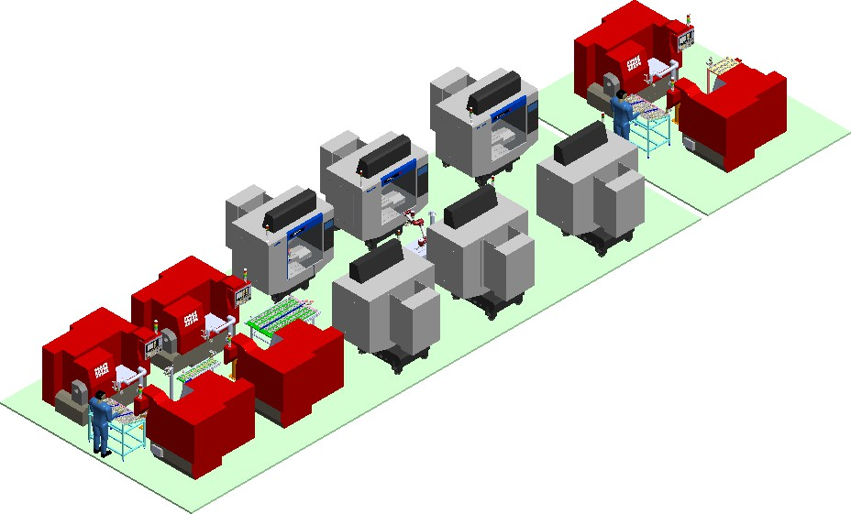
BMW RAD LINE
3D Floor Layout
LGB l Operations Technology

Slide 31
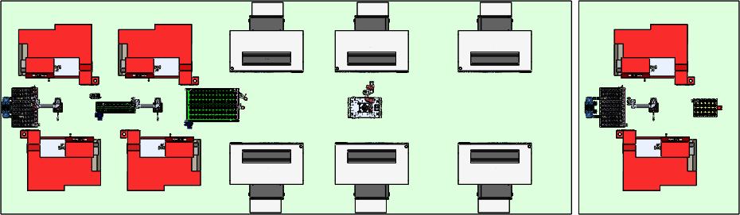
BMW RAD LINE
2D Floor Layout
OP10-1
OP20-1
OP30-1
OP30-2
OP30-3
OP40-1
I/P Feeding
Table
I/P Feeding Table
Flipping unit
O/P Table
Jack AMR + Cobot-3 (Jaka)
C1
Co1
C2
Co2
C4
Co3
OP10-2
OP20-2
OP30-4
OP30-5
OP30-6
OP40-2
LGB l Operations Technology

Slide 32
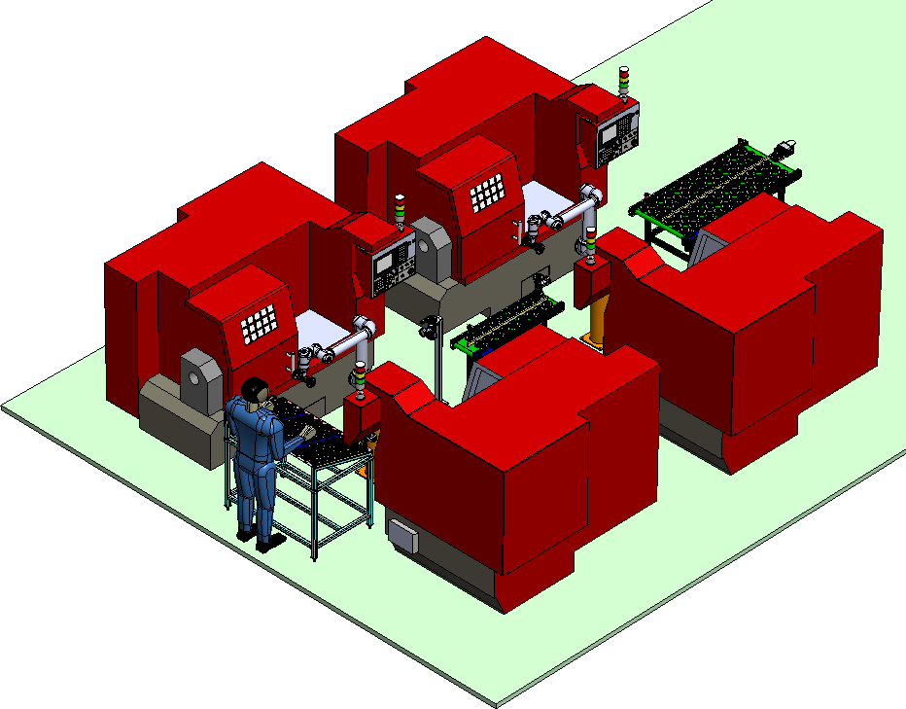
PO DETAILS - DAIMLER LINE
LGB l Operations Technology

Slide 33
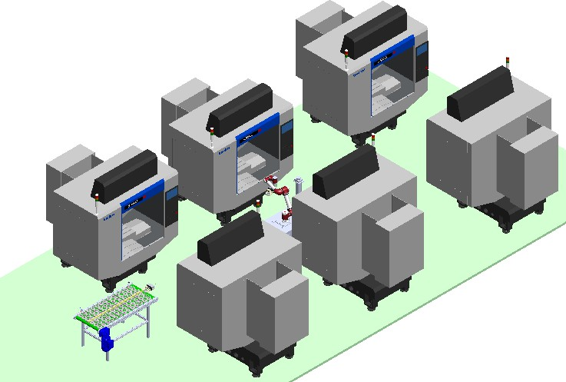
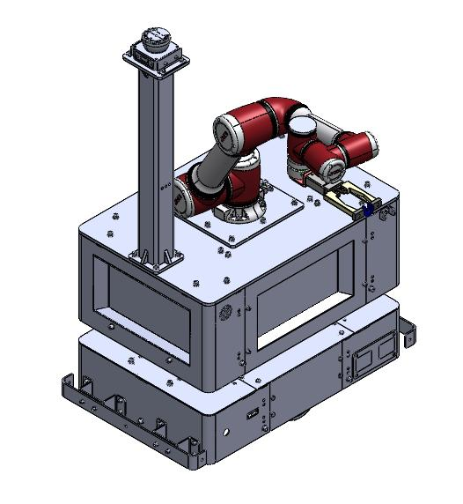
BMW RAD LINE
Key Station Detail — OP30
Implemented one AMR with jack cobot for 5 VMC machines.
Automates material handling with a 6-minute machine cycle time.
LGB l Operations Technology

Slide 34
PO DETAILS - DAIMLER LINE
LGB l Operations Technology

Slide 35
PO DETAILS - DAIMLER LINE
LGB l Operations Technology

Slide 36
PROJECT BOM - BMW RAD LINE
BOM | UOM | QTY | UNIT COST | TOTAL COST
Design & Engineering
PLC Program | Lot | 1 | ₹1,00,000 | ₹1,00,000
Project Management | Lot | 1 | ₹45,000 | ₹45,000
Drawing and Documentation | Lot | 1 | ₹20,000 | ₹20,000
Robots & AMR
UR 12e | Nos | 3 | ₹18,35,000 | ₹55,05,000
AMR | Nos | 1 | ₹12,75,000 | ₹12,75,000
Cobot & camera | Nos | 1 | ₹11,20,000 | ₹11,20,000
Gripper & Fingure
Gripper & Fingure | Nos | 6 | ₹1,68,800 | ₹10,12,800
Electrical Gripper & Fingure | Nos | 1 | ₹2,95,800 | ₹2,95,800
Mechanical Accessories
Pedestal | Nos | 3 | ₹1,06,600 | 140000
Belt conveyor | Lot | 3 | ₹1,06,600 | ₹3,19,800
E&I
HMI , PLC | Lot | 1 | ₹11,53,000 | ₹11,53,000
Control Panel | Lot | 1
Teach Pendant | Lot | 1 | Inculaded in system price | Inculaded in system price
Installation & Commissioning | Lot | 1 | ₹4,29,000 | ₹4,29,000
Digitalization | Lot` | 1 | Inculaded in system price | Inculaded in system price
TOTAL |  |  |  | ₹1,45,98,488

Slide 37
NO OF MANPOWER REDUCED - BMW RAD LINE
Manpower Reduction – BMW RAD LINE Automation
S.No | Station / Operation | Manpower / Per shift (Manual) | Manpower / Per shift (After Automation) | Manpower Reduced / Per shift | Avg. Monthly Cost per Head (₹) / Per shift | Monthly Cost Savings (₹) / Per shift
1 | OP10 Machine Operation | 2 | 1 | 1 | ₹22,000 x 1 | ₹22,000
2 | OP20 Machine Operation | 2 | 0 | 2 | ₹22,000 x 2 | ₹44,000
3 | OP30 Machine Operation | 5 | 1 | 4 | ₹22,000 x 4 | ₹88,000
4 | OP40 Machine Operation | 2 | 1 | 1 | ₹22,000 x 1 | ₹22,000
 | TOTAL MANPOWER PER SHIFT | 11 | 3 | 8 |  | ₹1,76,000
Summary | VALUE
Total Manpower Before (Manual) / Per shift | 11
Total Manpower After (Automation) / Per shift | 3
Total Manpower Reduced / Per shift | 8
% Manpower Reduction / Per shift | 72.7%
Total Monthly Cost Savings / Per shift | ₹1,76,000
Total Annual Cost Savings / Per Shift | ₹21,12,000
LGB l Operations Technology

Slide 38
ROI CALCULATION - BMW RAD LINE
Parameter | Calculation | Value
Total Machines Automated |  | 11
Total Cobots Used |  | 4Cobot + 1 AMR
Operators Required per Shift (Current) |  | 11
Total Shifts per Day |  | 3
Total Operators Required per Day (Current) | 11 × 3 | 33
Salary per Operator per Month |  | ₹ 22,000
Current Monthly Manpower Cost | 33 × 22,000 | ₹ 7,26,000
Current Annual Manpower Cost | 7,26,000 × 12 | ₹ 87,12,000
Operators Required After Automation |  | 9
Monthly Manpower Cost After Automation | 9 × 22,000 | ₹ 1,98,000
Annual Manpower Cost After Automation | 1,98,000 × 12 | ₹ 23,76,000
Annual Savings Due to Automation | 87,12,000 − 23,76,000 | ₹ 63,86,000
Total Automation Project Cost |  | ₹ 1,23,72,600
ROI Payback Period (Years) | 1,23,71,600 ÷ 63,86,000 | 1.93 Years
ROI Payback Period (Months) | 1.93 × 12 | 23 Months
Operator Reduction | 11 − 03 | 08 Operators Reduced
Savings After 5 Years | (63,86,000 × 5) − 1,23,71,600 | ₹ 1,95,58,400
LGB l Operations Technology

Slide 39
CYCLE TIME CALCULATION - BMW RAD LINE
Part No 841 | output/hr | output/shift | output/day | Production actual/ month(nos) | efficiency | cnc machine | cobot
OP 10/per one machine | 26 | 209 | 588 | 15,288 | 85% | 2 | 1 cobot
 |  |  |  |  |  |  | 1 cobot
OP 20/per one machine | 26 | 207 | 583 | 15,163 | 85% | 2
OP 30/per one machine | 07 | 55 | 155 | 4,025 | 85% | 6 | 1 cobot + 1 AMR
OP 40/per one machine | 18 | 144 | 405 | 10,530 | 85% | 2 | 1 cobot
LGB l Operations Technology

Slide 40
PO DETAILS - BMW RAD LINE
INVOICING PLAN – STELLANTIS ROBOTIC LINE PROJECT
S No. | Milestone Payment % | Milestone Payment Description | Amount (₹) | Planned Invoice Date | Actual Invoice Date | Invoice No. | Payment Status | Remark
1 | 70% | Advance to Supplier | ₹₹28,05,600 | Jun-2026 (PO date) | 15-Jun-2026 |  | Paid | Advance paid
2 | 20% | Upon Delivery at Site | ₹60,78,800 | Oct -2026 |  |  | Pending | Delivary at Site
3 | 10% | Upon Installation & Commissioning | ₹4,67,600 | Nov-2026 |  |  | Pending | Installation & Commissioning
Total | 100% |  | ₹1,23,71,600
LGB l Operations Technology

Slide 41
ACTIVITY IMPLEMENTATION STATUS - BMW RAD LINE
BMW RAD LINE ACTIVITY CHART
 | Jun |  |  |  | Jul |  |  |  | Aug |  |  |  | Sep |  |  |  | Oct |  |  |  | Nov
Week | 1 | 2 | 3 | 4 | 5 | 6 | 7 | 8 | 9 | 10 | 11 | 12 | 13 | 14 | 15 | 16 | 17 | 18 | 19 | 20 | 21 | 22 | 23 | 24
Receipt of Purchase order / LOI |  |  | x | x
Detailed layout , Drawing and BOQ submission for Approval |  |  |  | x | x | x | x
Manufacturing - Mechanical |  |  |  |  |  |  | x | x | x | x | x | x | x | x
Manufacturing - Electrical |  |  |  |  |  | x | x | x | x | x | x | x | x | x
Assembly - Mechanical |  |  |  |  |  |  |  |  | x | x | x | x | x | x | x | x
Assembly - Electrical (including Panel interface) |  |  |  |  |  |  |  | x | x | x | x | x | x | x | x | x
Internal Trials (no load test) |  |  |  |  |  |  |  |  |  |  |  |  | x | x | x | x
FAT Test |  |  |  |  |  |  |  |  |  |  |  |  |  |  |  |  | x | x
I&C |  |  |  |  |  |  |  |  |  |  |  |  |  |  |  |  |  |  | x | x | x | x | x
LGB l Operations Technology

Slide 42
03
Helical Machine Tending Line

Slide 43
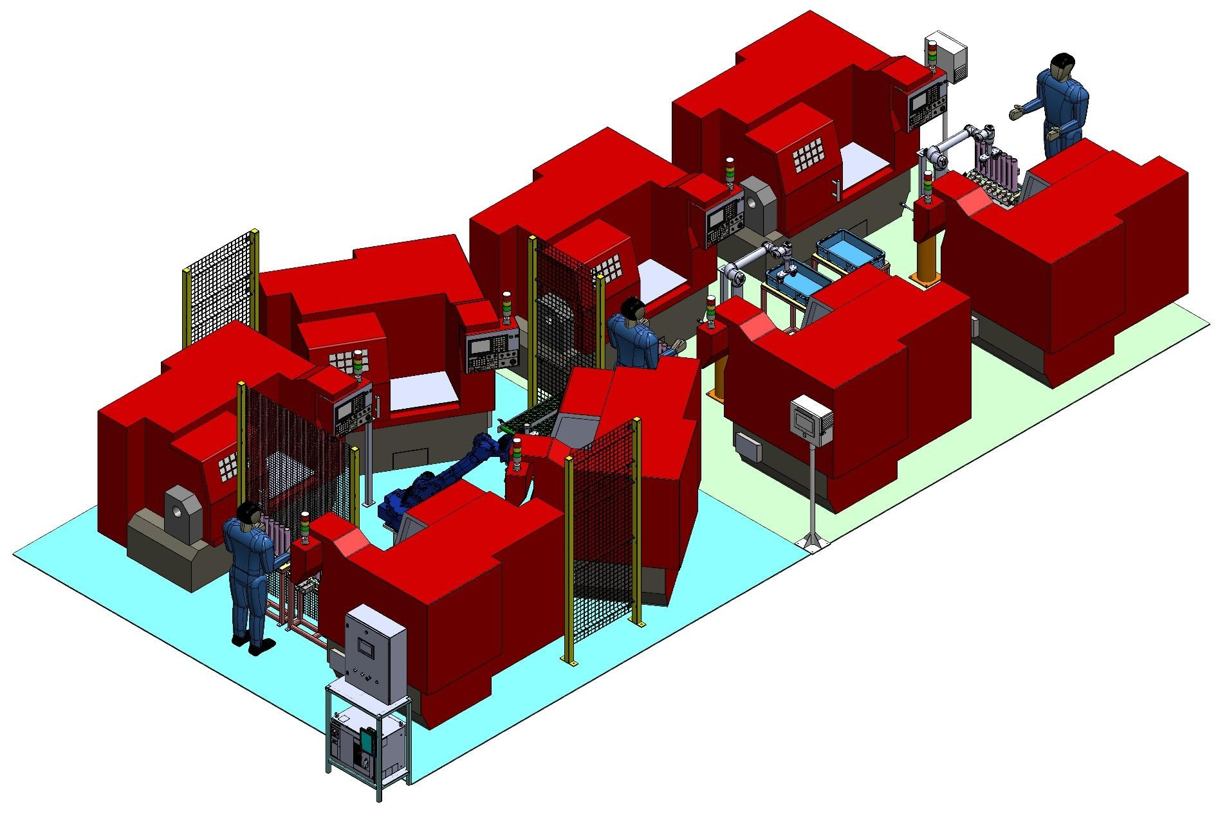
HELICAL LINE
3D Isometric Layout
LGB l Operations Technology

Slide 44
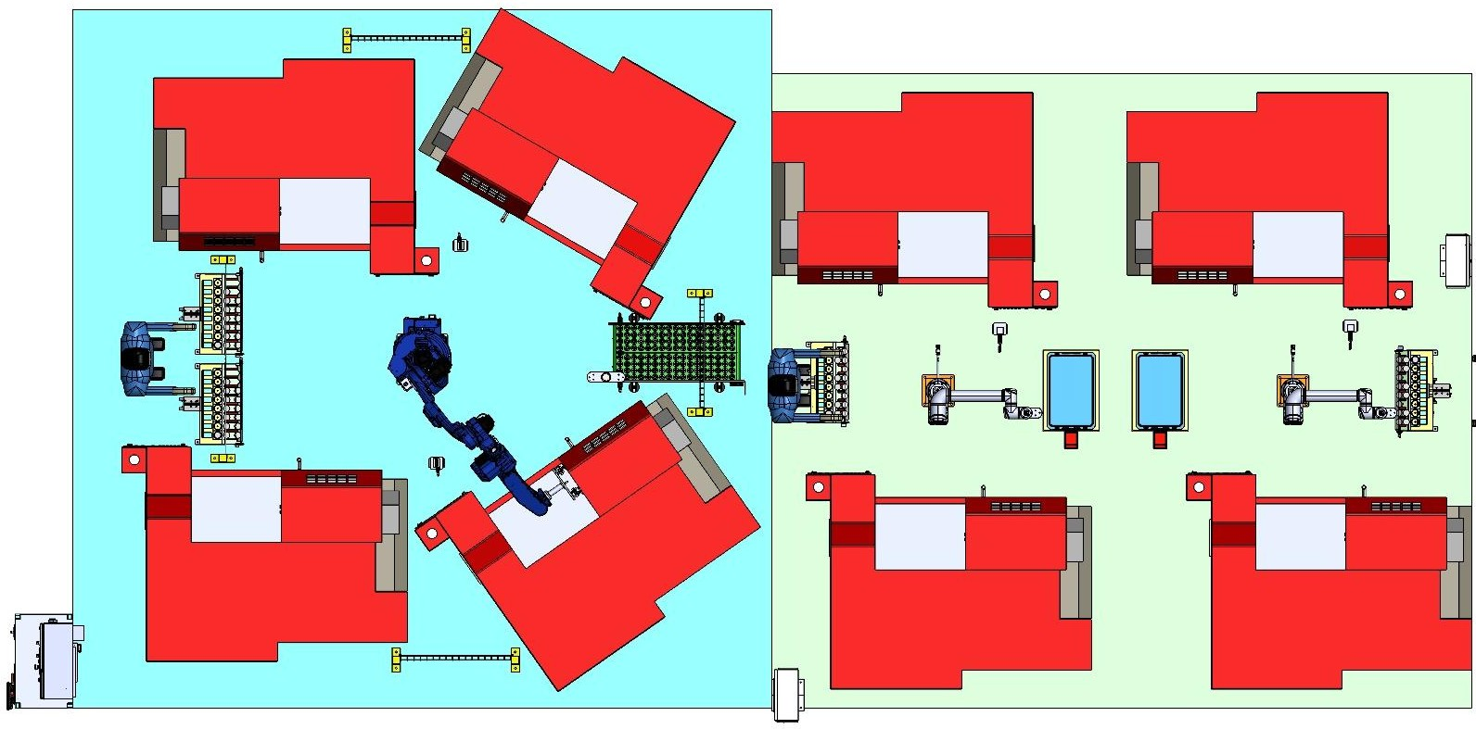
HELICAL LINE
2D Floor Layout
Part No. 981/982
Part No. 1386/1790
1
10 Product 1386 I/P
Product 981 I/P
2
Product 982 I/P
981 OP10-1
11
1386 OP10-1
3
12
1386 OP20-1
4
3
11
16
Cobot 1 (UR12e)
Product 1386 O/P
4
981OP20-1
13
1
2
5
982 OP10-2
14
7
8
14
19
15
9
10
13
6
982 OP20-2
15
Product 1790 I/P
18
7
Robot(GP25-12)
Product 981 O/P
16
1790 OP10-2
1790 OP20-2
18 Cobot 2 (UR12e)
Product 1790 O/P
8
17
5
6
12
17
9 Product 982 O/P
19
LGB l Operations Technology

Slide 45
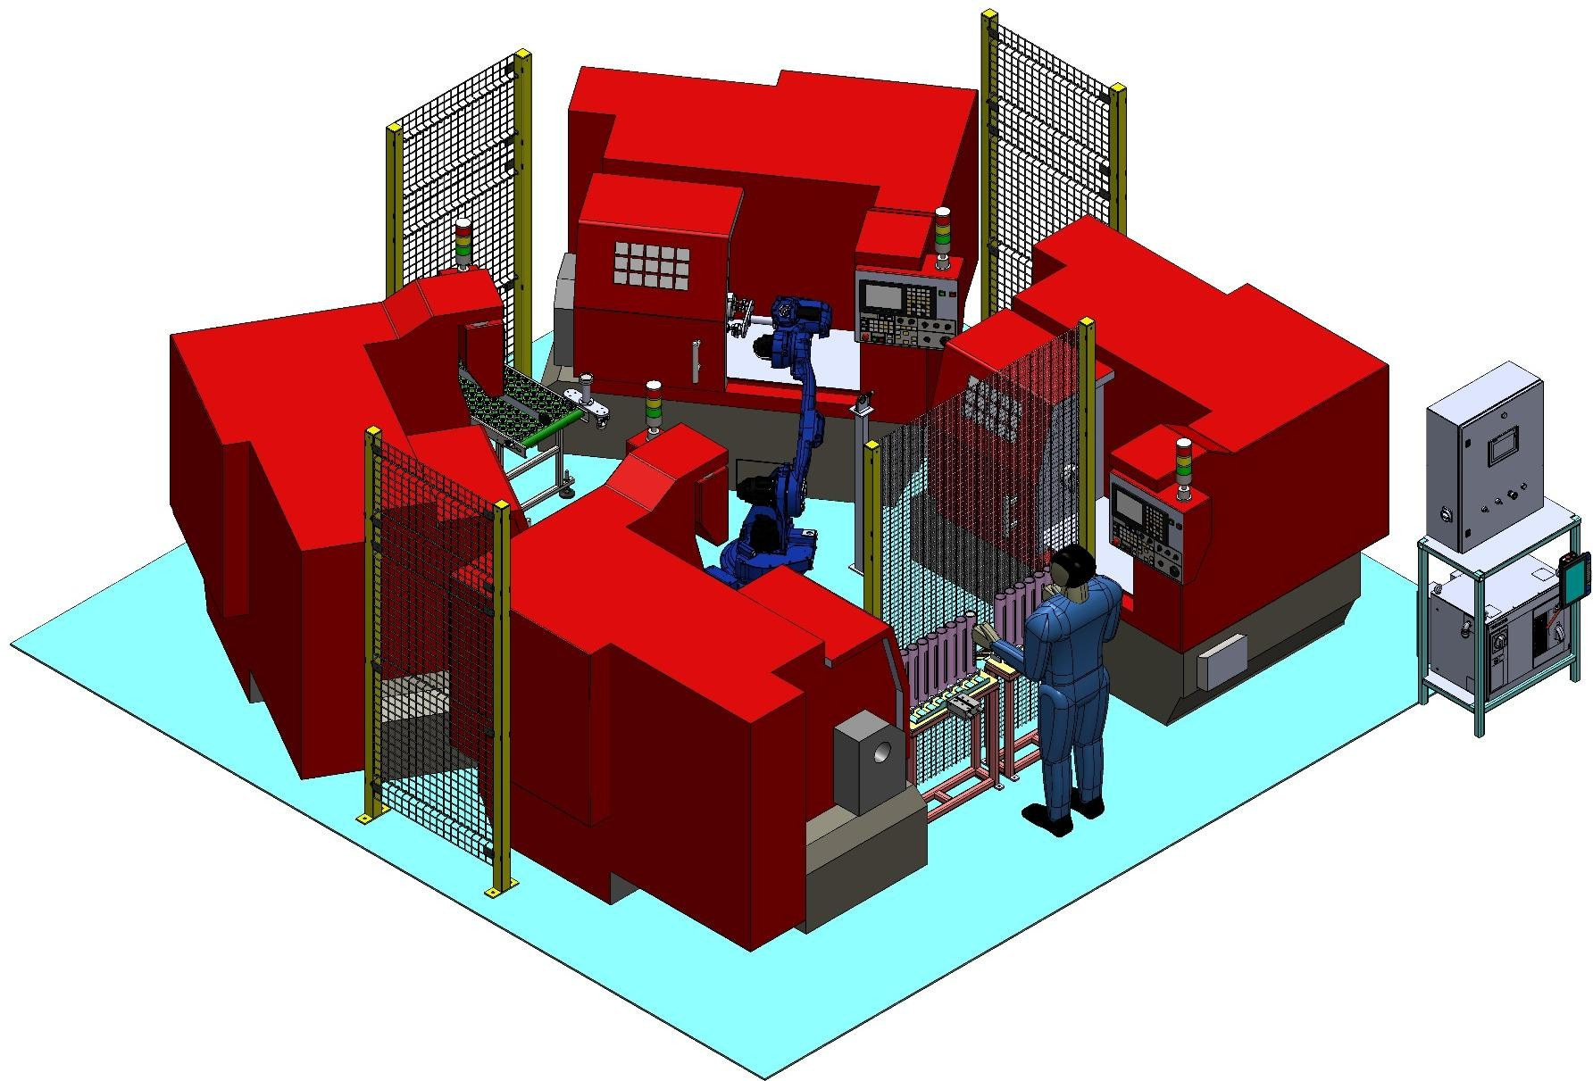
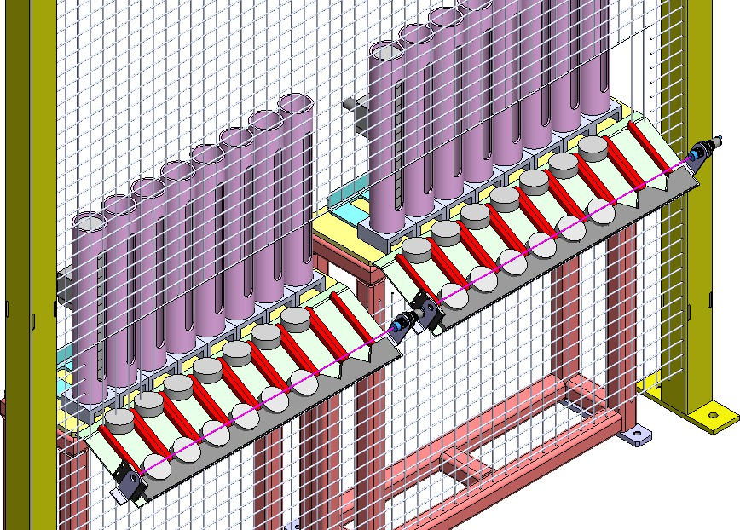
HELICAL LINE
Detail view for 4 M/C with 1 robot
LGB l Operations Technology

Slide 46
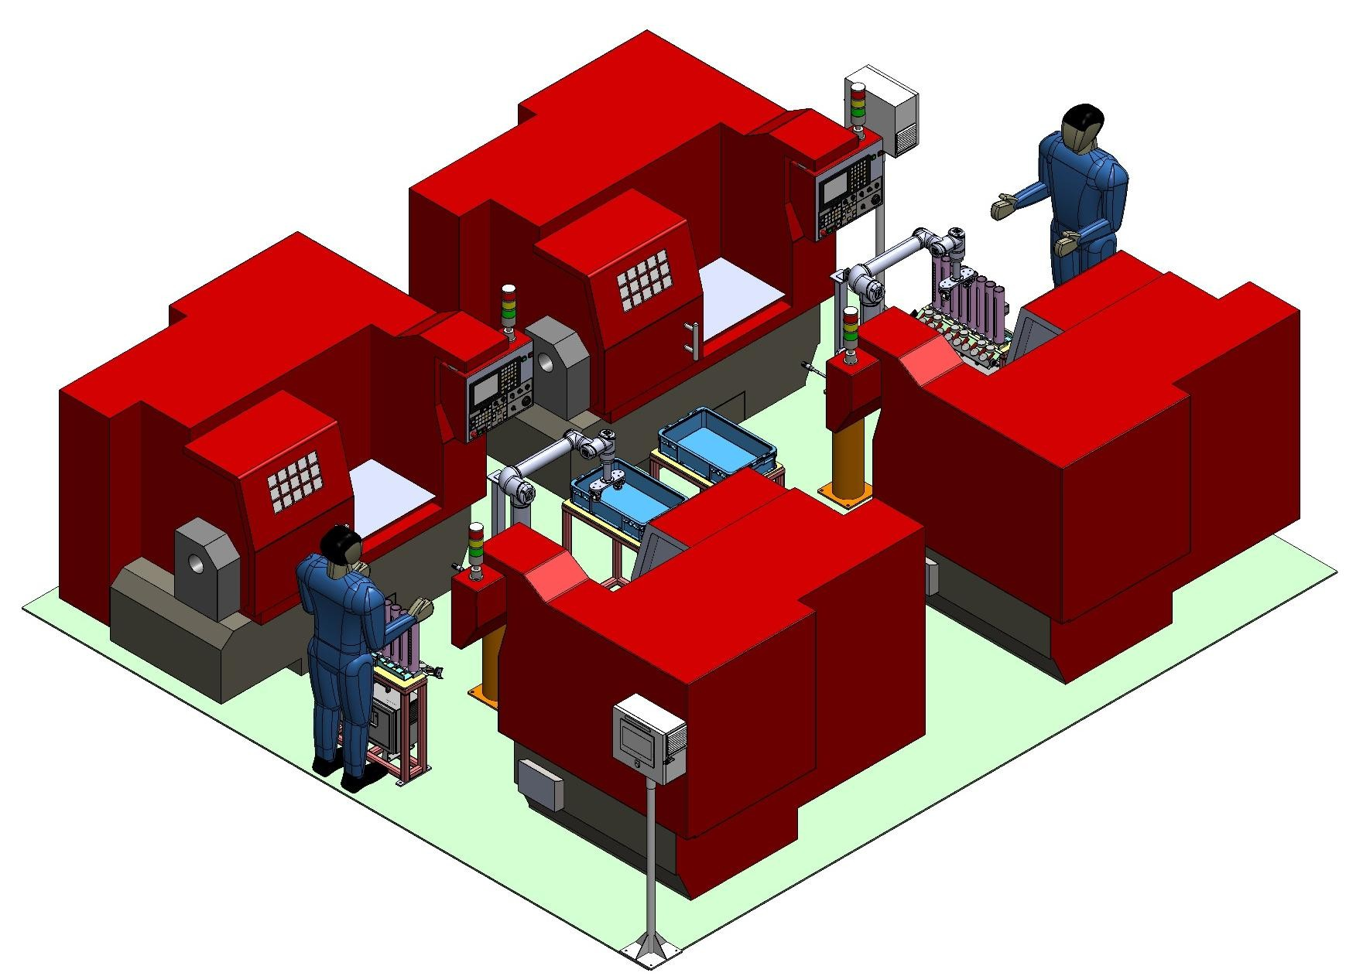
PROJECT BOM - HELICAL LINE
LGB l Operations Technology

Slide 47
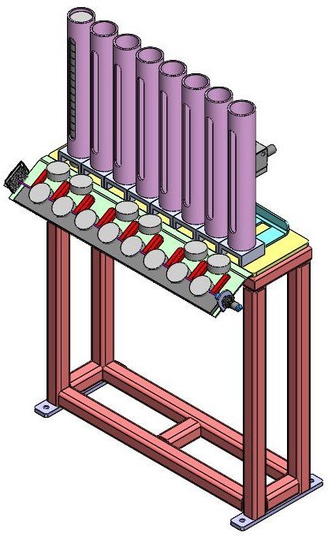
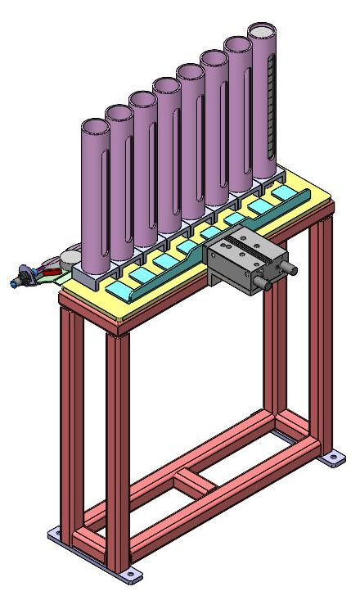
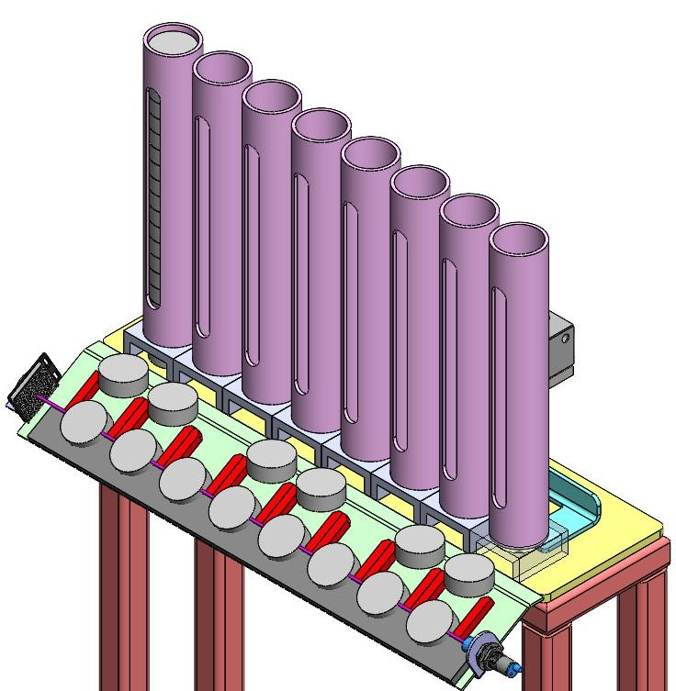
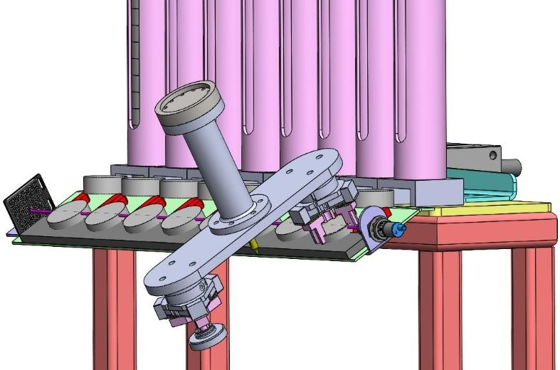
ROI CALCULATION - HELICAL LINE
With Component Table view
Table side view
Table Overall view
20 X 8 - 160 PARTS LOADING IN 1 INPUT TABLE. Total INPURT TABLE – 1Nos= 160 PARTS
LGB l Operations Technology

Slide 48
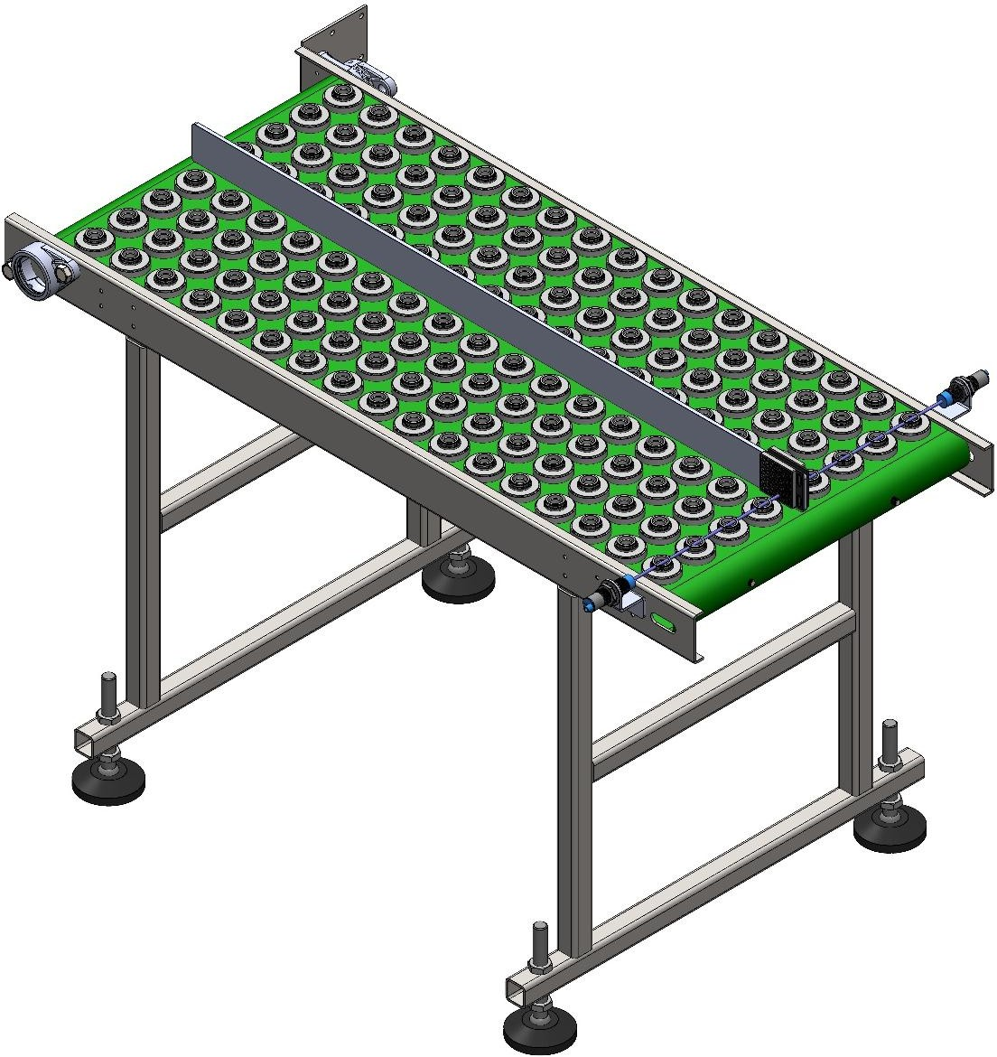
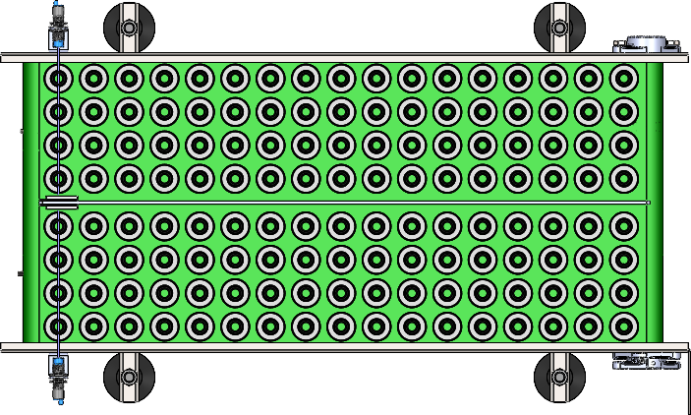
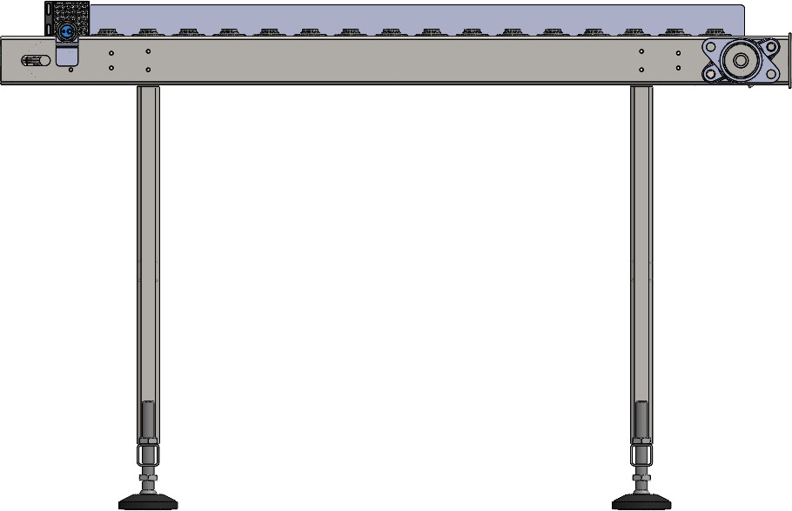
ROI CALCULATION - HELICAL LINE
Output conveyor Each Path-68 Nos.
LGB l Operations Technology

Slide 49
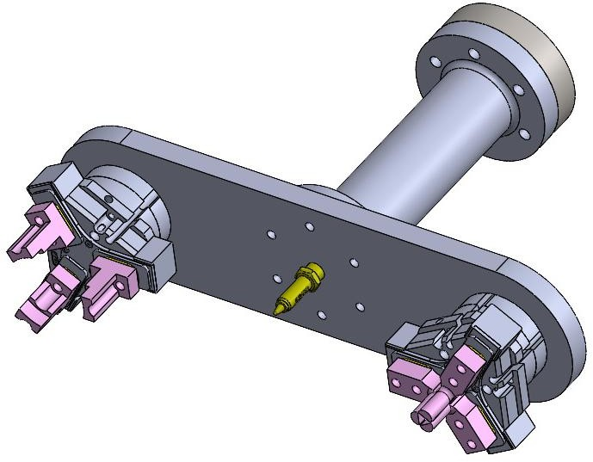
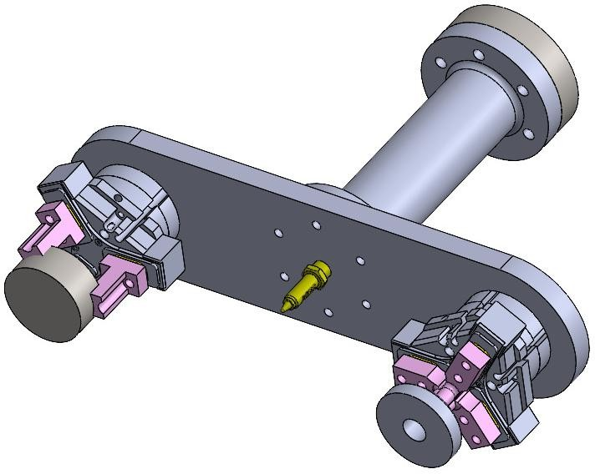
PROJECT BOM - HELICAL LINE
Gripper Without part
Gripper with part holding
LGB l Operations Technology

Slide 50
PO DETAILS - DAIMLER LINE
LGB l Operations Technology

Slide 51
PO DETAILS - DAIMLER LINE
LGB l Operations Technology

Slide 52
PO DETAILS - DAIMLER LINE
LGB l Operations Technology

Slide 53
PO DETAILS - DAIMLER LINE
LGB l Operations Technology

Slide 54
PROJECT BOM - HELICAL LINE
BOM | UOM | QTY | UNIT COST | TOTAL COST
Design & Engineering
PLC Program | Lot | 1 | ₹1,00,000 | ₹1,00,000
Project Management | Lot | 1 | ₹45,000 | ₹45,000
Drawing and Documentation | Lot | 1 | ₹20,000 | ₹20,000
Robots & AMR
UR 12e | Nos | 2 | ₹18,35,000 | ₹36,70,000
Yaskawa | Nos | 1 | ₹14,50,000 | ₹14,50,000
Gripper & Fingure
Gripper & Fingure | Nos | 6 | ₹1,38,500 | ₹8,31,000
Mechanical Accessories
Pedestal | Nos | 3 | ₹16,27,000 | ₹16,27,000
Input table & Other | Lot | 1
E&I
HMI , PLC | Lot | 1 | ₹9,63,000 | ₹9,63,000
Control Panel | Lot | 1
Installation & Commissioning | Lot | 1 | ₹4,62,000 | ₹4,62,000
Digitalization | Lot | 1 | Inculaded in system price | Inculaded in system price
TOTAL |  |  |  | ₹93,52,000
LGB l Operations Technology

Slide 55
NO OF MANPOWER REDUCED - HELICAL LINE
Manpower Reduction – HELICAL LINE Automation
S.No | Part No | Station / Operation | Manpower (Manual) / Per shift | Manpower (After Automation) / Per shift | Manpower Reduced / Per shift | Avg. Monthly Cost per Head (₹) / Per shift | Monthly Cost Savings (₹) / Per shift
1 | 981 | OP10 Machine Operation | 2 | 1 | 3 | ₹22,000 x 3 | ₹66,000
 |  | OP20 Machine Operation
2 | 982 | OP10 Machine Operation | 2
 |  | OP20 Machine Operation
3 | 1790 | OP10 Machine Operation | 2 | 1 | 3 | ₹22,000 x 3 | ₹66,000
 |  | OP20 Machine Operation
4 | 1386 | OP10 Machine Operation | 2
 |  | OP20 Machine Operation
TOTAL MANPOWER PER SHIFT |  |  | 8 | 2 | 6 |  | ₹1,32,000
Summary | VALUE
Total Manpower Before (Manual) / Per shift | 8
Total Manpower After (Automation) / Per Shift | 2
Total Manpower Reduced / Per shift | 6
% Manpower Reduction / Per shift | 75.0%
Total Monthly Cost Savings / Per shift | ₹1,32,000
Total Annual Cost Savings / Per shift | ₹15,84,000
LGB l Operations Technology

Slide 56
ROI CALCULATION - HELICAL LINE
Parameter | Calculation | Value
Total Machines Automated |  | 08
Total Cobots Used |  | 1yaskava + 2UR 12e
Operators Required per Shift (Current) |  | 8
Total Shifts per Day |  | 3
Total Operators Required per Day (Current) | 8 × 3 | 24
Salary per Operator per Month |  | ₹ 22,000
Current Monthly Manpower Cost | 24 × 22,000 | ₹ 5,28,000
Current Annual Manpower Cost | 5,28,000 × 12 | ₹ 63,36,000
Operators Required After Automation |  | 6
Monthly Manpower Cost After Automation | 6 × 22,000 | ₹ 1,32,000
Annual Manpower Cost After Automation | 1,32,000 × 12 | ₹ 15,84,000
Annual Savings Due to Automation | 63,36,000 − 15,84,000 | ₹ 47,52,000
Total Automation Project Cost |  | ₹ 93,52,000
ROI Payback Period (Years) | 93,52,000 ÷ 47,52,000 | 1.96 Years
ROI Payback Period (Months) | 1.96 × 12 | 23 Months
Operator Reduction | 08 − 02 | 06 Operators Reduced
Savings After 5 Years | (47,52,000 × 5) − 93,52,000 | ₹ 1,44,08,000
LGB l Operations Technology

Slide 57
CYCLE TIME CALCULATION — OP10 & OP20 - HELICAL LINE
Part No | OP10 & OP20 output/hr | OP10 & OP20 output/shift | OP10 & OP20 output/day | OP10 & OP20 Production actual/ month(nos) | OP10 & OP20 efficiency | OP10 & OP20 cnc machine | OP10 & OP20 cobot
981 | 30 | 240 | 675 | 17,550 | 85% | 2 | 1 robot
982 | 30 | 240 | 675 | 17,550 | 85% | 2
1386 | 60 | 480 | 1,350 | 35,100 | 85% | 2 | 1 cobot
1790 | 60 | 480 | 1,350 | 35,100 | 85% | 2 | 1 cobot
LGB l Operations Technology

Slide 58
PO DETAILS - HELICAL LINE
INVOICING PLAN – STELLANTIS ROBOTIC LINE PROJECT
S No. | Milestone Payment % | Milestone Payment Description | Amount (₹) | Planned Invoice Date | Actual Invoice Date | Invoice No. | Payment Status | Remark
1 | 30% | Advance to Supplier | ₹₹28,05,600 | Jun-2026 (PO date) | 15-Jun-2026 |  | Paid | Advance paid
2 | 65% | Upon Delivery at Site | ₹60,78,800 | Oct -2026 |  |  | Pending | Delivary at Site
3 | 5% | Upon Installation & Commissioning | ₹4,67,600 | Nov-2026 |  |  | Pending | Installation & Commissioning
Total | 100% |  | ₹93,52,000
LGB l Operations Technology

Slide 59
ACTIVITY IMPLEMENTATION STATUS - HELICAL LINE
HELICAL LINE ACTIVITY CHART
 | Jun |  |  |  | Jul |  |  |  | Aug |  |  |  | Sep |  |  |  | Oct |  |  |  | Nov
Week | 1 | 2 | 3 | 4 | 5 | 6 | 7 | 8 | 9 | 10 | 11 | 12 | 13 | 14 | 15 | 16 | 17 | 18 | 19 | 20 | 21 | 22 | 23 | 24
Receipt of Purchase order / LOI |  |  | x | x
Detailed layout , Drawing and BOQ submission for Approval |  |  |  | x | x | x | x
Manufacturing - Mechanical |  |  |  |  |  |  | x | x | x | x | x | x | x | x
Manufacturing - Electrical |  |  |  |  |  | x | x | x | x | x | x | x | x | x
Assembly - Mechanical |  |  |  |  |  |  |  |  | x | x | x | x | x | x | x | x
Assembly - Electrical (including Panel interface) |  |  |  |  |  |  |  | x | x | x | x | x | x | x | x | x
Internal Trials (no load test) |  |  |  |  |  |  |  |  |  |  |  |  | x | x | x | x
FAT Test |  |  |  |  |  |  |  |  |  |  |  |  |  |  |  |  | x | x
I&C |  |  |  |  |  |  |  |  |  |  |  |  |  |  |  |  |  |  | x | x | x | x | x
Current status - DAP Submission
LGB l Operations Technology

Slide 60
04
Ather line Machine Tending

Slide 61
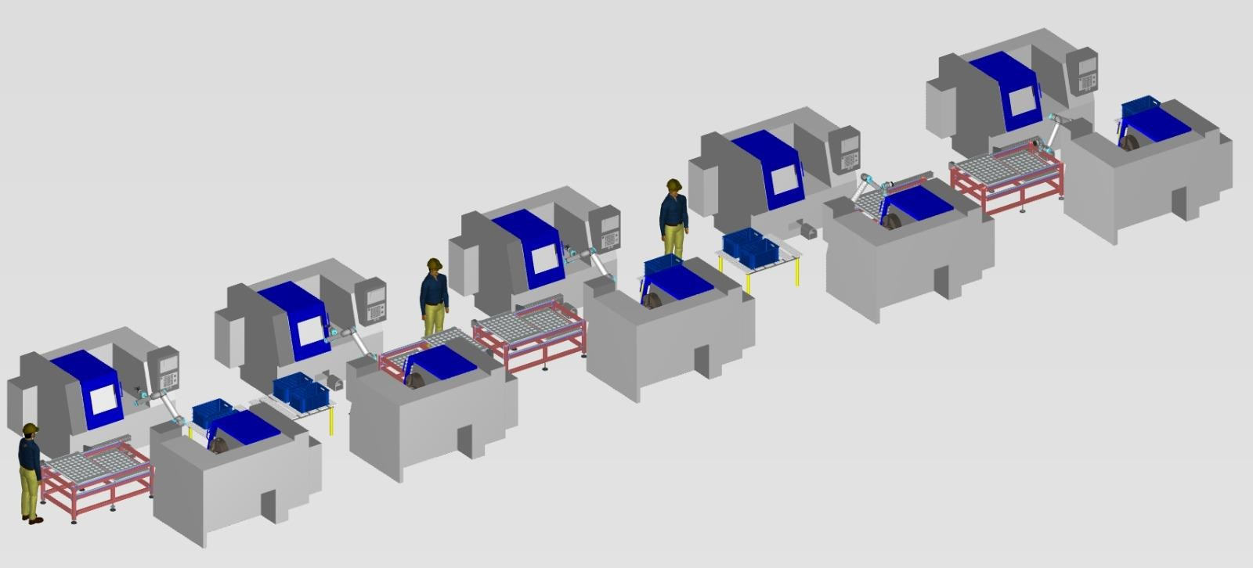
ATHER LINE
3D Isometric Layout
LGB l Operations Technology

Slide 62
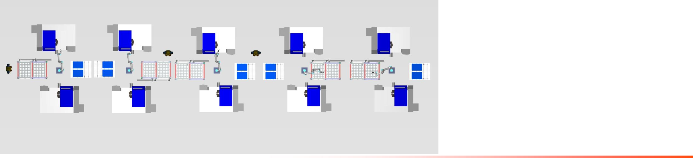
ATHER LINE
1564A
Product I/P
1564B
1561B
1
Product I/P
Product I/P
21
11
22 OP10 CNC OP20 CNC
2
OP10 CNC 1
OP20 CNC 1
OP10 CNC OP20 CNC
12
23
3
13
24
Cobot 5
4
Cobot 1
14 Cobot 3
Output Table
1563 O/P Table
1561A
25
1564A O/P
Table
5
15
1563
6
Product I/P
2
7
12
17
22
7
OP10 CNC 2
Product I/P
OP10 CNC
16
1
8
OP20 CNC 2
Cobot 2 1563 O/P
Table
17
4
3
5
10
11
20
21
9
6
19
16
24
OP20 CNC
14
25
9
18
15
19
Cobot 4
13
18
23
10
8
20
1561A O/P Table
LGB l Operations Technology

Slide 63
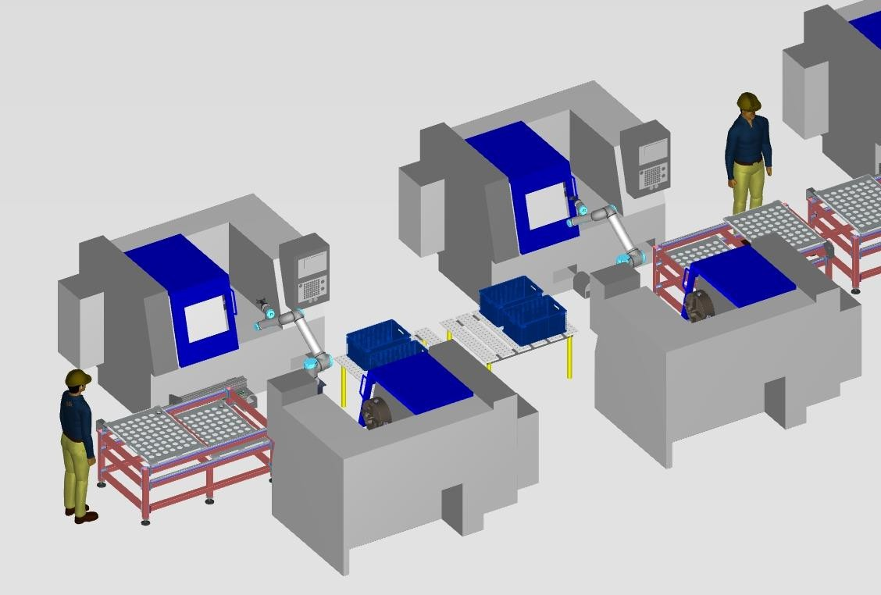
ATHER LINE
Detail view for OP10 & OP20
Product Input OP10 CNC – 1 OP20 CNC – 1
Cobot 1 Output Table
1
7
2
3
2
6
4
9
5
5
6
Product I/P
4
10
8
7 OP10 CNC 2
8 OP20 CNC 2
Cobot 2
1564B O/P Table
1
3
9
10
LGB l Operations Technology

Slide 64
PROJECT BOM - ATHER LINE
BOM | UOM | QTY | UNIT COST | TOTAL COST
Design & Engineering
PLC Program | Lot | 1 | ₹56,000 | ₹56,000
Project Management | Lot | 1 | ₹50,000 | ₹50,000
Drawing and Documentation | Lot | 1 | ₹2,04,000 | ₹2,04,000
Robots & AMR
ABB 12kg | Nos | 5 | ₹17,40,000 | ₹87,00,000
Gripper & Fingure
Gripper | Nos | 10 | ₹55,100 | ₹5,51,000
Fingure | Nos | 10 | ₹1,76,000 | ₹1,76,000
Mechanical Accessories
Pedestal | Nos | 5 | ₹31,600 | ₹1,58,000
Input table & Other | Lot | 1 | ₹8,30,000 | ₹8,30,000
E&I
HMI , PLC | Lot | 1 | ₹3,90,000 | ₹3,90,000
Control Panel | Lot | 1 | ₹4,29,000 | ₹4,29,000
Installation & Commissioning | Lot | 1 | ₹2,74,000 | ₹2,74,000
Digitalization | Lot` | 1 | Inculaded in system price | Inculaded in system price
TOTAL |  |  |  | ₹1,29,82,000
LGB l Operations Technology

Slide 65
NO OF MANPOWER REDUCED - ATHER LINE
Manpower Reduction – ATHER LINE Automation
S.No | Part No. | Station / Operation | Manpower (Manual) / Per shift | Manpower (After Automation) / Per shift | Manpower Reduced / Per shift | Avg. Monthly Cost per Head (₹) / Per shift | Monthly Cost Savings (₹) / Per shift
1 | 1564A | OP10 Machine Operation | 2 | 1 | 5 | ₹22000 x 5 | ₹1,10,000
 |  | OP20 Machine Operation
2 | 1564B | OP10 Machine Operation | 2
 |  | OP20 Machine Operation
3 | 1563 | OP10 Machine Operation | 2
 |  | OP20 Machine Operation
4 | 1561A | OP10 Machine Operation | 2
 |  |  |  |  |  |  | ₹66,000
 |  |  |  |  |  | ₹22,000 x 3
 |  |  |  |  | 3
 |  |  |  | 1
 |  | OP20 Machine Operation
5 | 1561B | OP10 Machine Operation | 2
 |  | OP20 Machine Operation
TOTAL MANPOWER PER SHIFT |  |  | 10 | 2 | 8 |  | ₹1,76,000
Summary | VALUE
Total Manpower Before (Manual) / Per shift | 10
Total Manpower After (Automation) / Per shift | 2
Total Manpower Reduced / Per shift | 8
% Manpower Reduction / Per shift | 80.0%
Total Monthly Cost Savings / Per shift | ₹1,76,000
Total Annual Cost Savings / Per shift | ₹21,12,000
LGB l Operations Technology

Slide 66
ROI CALCULATION - ATHER LINE
Parameter | Calculation | Value
Total Machines Automated |  | 10
Total Cobots Used |  | 5 ABB 12kg
Operators Required per Shift (Current) |  | 10
Total Shifts per Day |  | 3
Total Operators Required per Day (Current) | 10 × 3 | 30
Salary per Operator per Month |  | ₹ 22,000
Current Monthly Manpower Cost | 30 × 22,000 | ₹ 6,60,000
Current Annual Manpower Cost | 6,60,000 × 12 | ₹ 79,20,000
Operators Required After Automation |  | 6
Monthly Manpower Cost After Automation | 6 × 22,000 | ₹ 1,32,000
Annual Manpower Cost After Automation | 1,32,000 × 12 | ₹ 15,84,000
Annual Savings Due to Automation | 79,20,000 − 15,84,000 | ₹ 63,36,000
Total Automation Project Cost |  | ₹ 1,29,82,000
ROI Payback Period (Years) | 1,29,82,000 ÷ 63,36,000 | 2.0 Years
ROI Payback Period (Months) | 2.0 × 12 | 24 Months
Operator Reduction | 10 − 02 | 08 Operators Reduced
Savings After 5 Years | (63,36,000 × 5) − 1,29,82,000 | ₹ 1,86,98,000
LGB l Operations Technology

Slide 67
CYCLE TIME CALCULATION — OP10 & OP20 - ATHER LINE
Part No | OP10 & OP20 output/hr | OP10 & OP20 output/shift | OP10 & OP20 output/day | OP10 & OP20 Production actual/ month(nos) | OP10 & OP20 efficiency | OP10 & OP20 Production requirement/ month(nos) | OP10 & OP20 cnc machine | OP10 & OP20 cobot
1564 B -1 | 25 | 188 | 563 | 14625 | 85% | 13000 | 2 | 1
1564 B -2 | 25 | 188 | 563 | 14625 | 85% | 13000 | 2 | 1
1563 | 29 | 218 | 653 | 16965 | 85% | 13000 | 2 | 1
1561 A | 42 | 315 | 945 | 24570 | 85% | 13000 | 2 | 1
1564 A | 39 | 293 | 878 | 22815 | 85% | 13000 | 2 | 1
LGB l Operations Technology

Slide 68
PO DETAILS - ATHER LINE
INVOICING PLAN – STELLANTIS ROBOTIC LINE PROJECT
S No. | Milestone Payment % | Milestone Payment Description | Amount (₹) | Planned Invoice Date | Actual Invoice Date | Invoice No. | Payment Status | Remark
1 | 50% | Advance to Supplier | ₹₹64,91,000 | 01-Jul-2026 (PO date) |  |  | Pending | Advance paid
2 | 40% | Upon Delivery at Site | ₹51,92,800 | 20-Oct -2026 |  |  | Pending | Delivary at Site
3 | 10% | Upon Installation & Commissioning | ₹12,98,200 | 10-Nov-2026 |  |  | Pending | Installation & Commissioning
Total | 100% |  | ₹1,29,82,000
LGB l Operations Technology

Slide 69
ACTIVITY IMPLEMENTATION STATUS - ATHER LINE
ATHER LINE ACTIVITY CHART
 | Jul |  |  |  | Aug |  |  |  | Sep |  |  |  | Oct |  |  |  | Nov |  |  |  | Dec
Week | 1 | 2 | 3 | 4 | 5 | 6 | 7 | 8 | 9 | 10 | 11 | 12 | 13 | 14 | 15 | 16 | 17 | 18 | 19 | 20 | 21 | 22 | 23 | 24
Receipt of Purchase order / LOI |  |  | x | x
Detailed layout , Drawing and BOQ submission for Approval |  |  |  | x | x | x | x
Manufacturing - Mechanical |  |  |  |  |  |  | x | x | x | x | x | x | x | x
Manufacturing - Electrical |  |  |  |  |  | x | x | x | x | x | x | x | x | x
Assembly - Mechanical |  |  |  |  |  |  |  |  | x | x | x | x | x | x | x | x
Assembly - Electrical (including Panel interface) |  |  |  |  |  |  |  | x | x | x | x | x | x | x | x | x
Internal Trials (no load test) |  |  |  |  |  |  |  |  |  |  |  |  | x | x | x | x
FAT Test |  |  |  |  |  |  |  |  |  |  |  |  |  |  |  |  | x | x
I&C |  |  |  |  |  |  |  |  |  |  |  |  |  |  |  |  |  |  | x | x | x | x | x
Current status - MD approval
LGB l Operations Technology

Slide 70
05
Daimler line Machine Tending

Slide 71
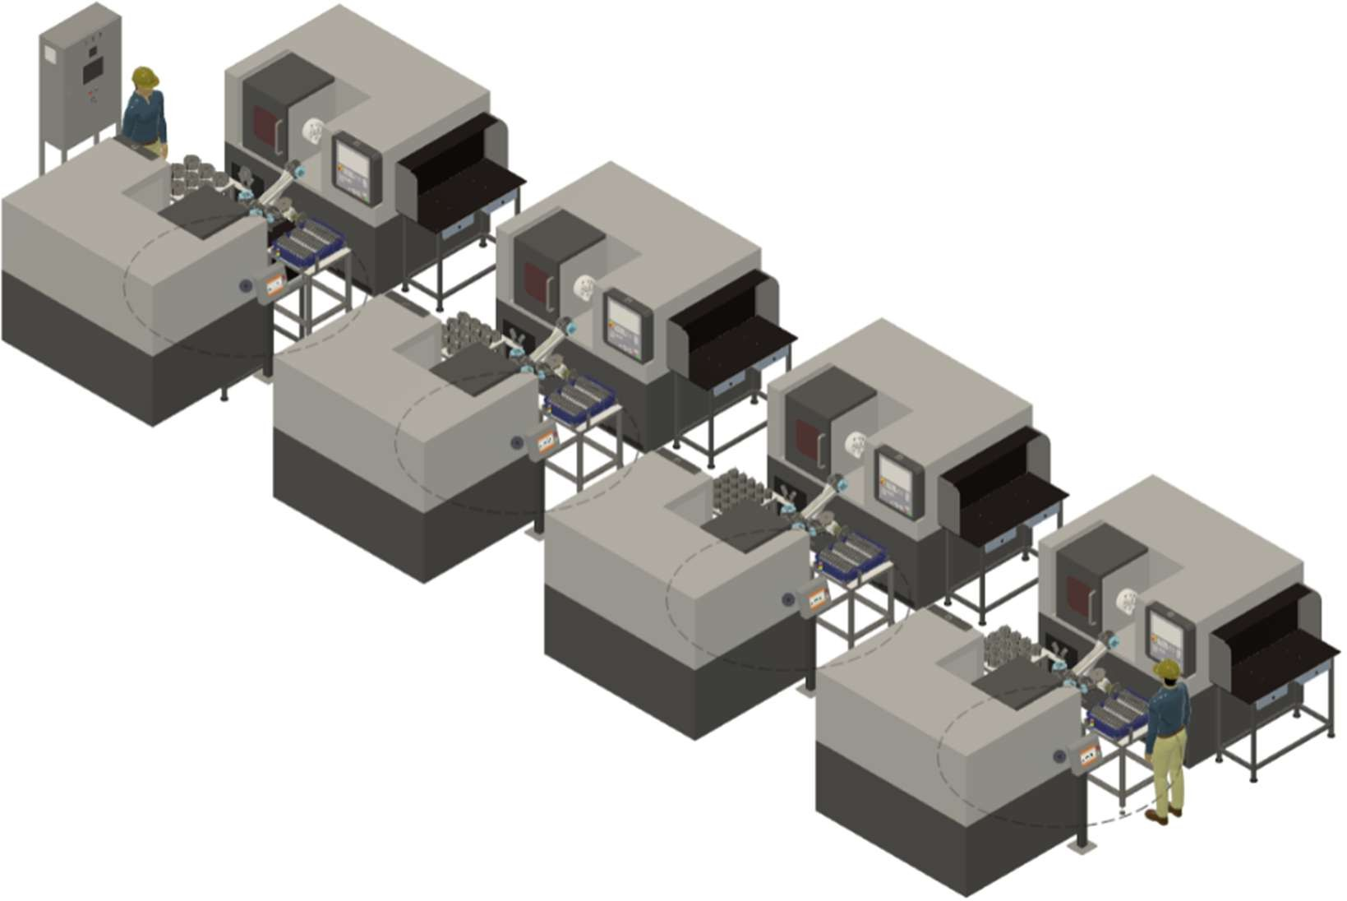
DAIMLER LINE
3D Isometric Layout
LGB l Operations Technology

Slide 72
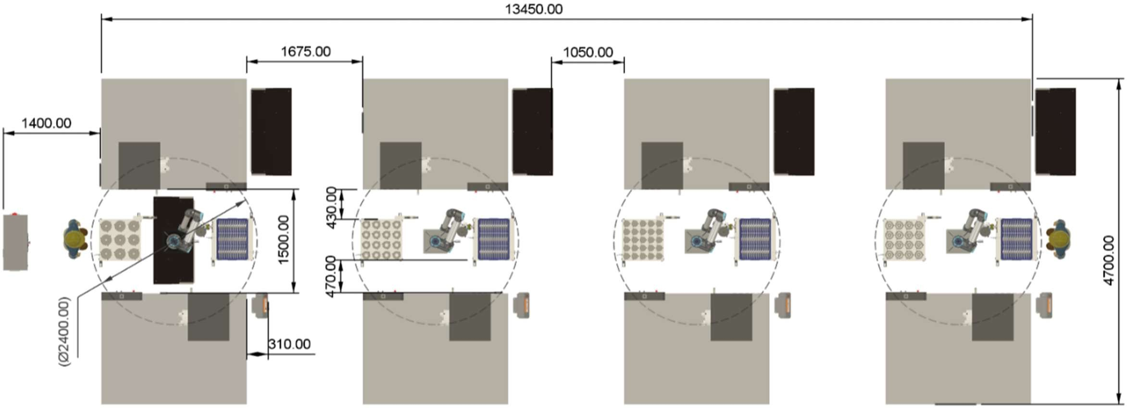
DAIMLER LINE
2D Floor Layout
LGB l Operations Technology

Slide 73
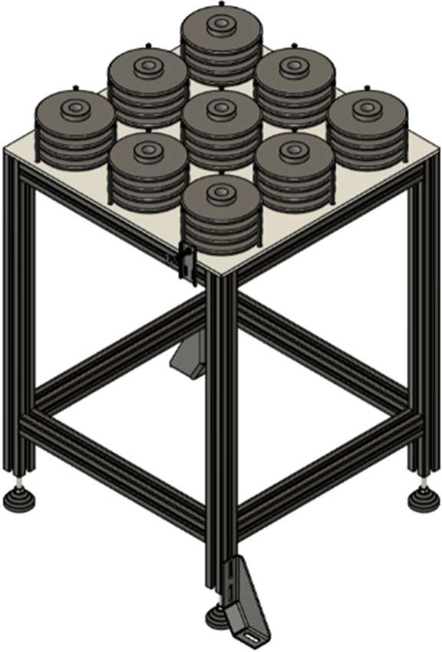
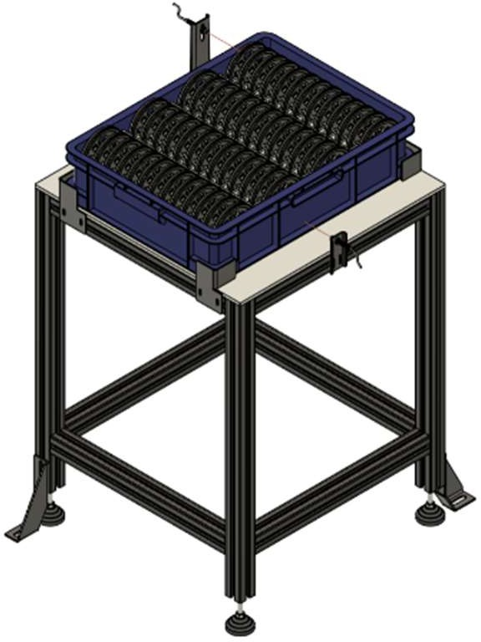
STELLANTIS LINE 1 - PHASE
Input Tray
Output Tray
Part presence sensor
Part presence sensor
Bin presence sensor
Aluminum Profile Frame
Aluminum Profile Frame
Grouting Bracket
Grouting Bracket
LGB l Operations Technology
20

Slide 74
PO DETAILS - DAIMLER LINE
LGB l Operations Technology

Slide 75
STELLANTIS LINE 1 - PHASE
CYCLE TIME CALCULATION
S.no | Part No | Output Per Hour | Output Per Shift | Output Per day | Production per Month Using Cobot | Production Requirement by customer | Efficiency
1 | 1217 | 24 | 180 | 540 | 14040 | 15000 | 85%
2 | 1218 | 21 | 157 | 472 | 12272 | 15000 | 85%
3 | 1361 | 30 | 225 | 675 | 17550 | 25000 | 85%
4 | 1142 | 19 | 142 | 427 | 11102 | 15000 | 85%
LGB l Operations Technology

Slide 76
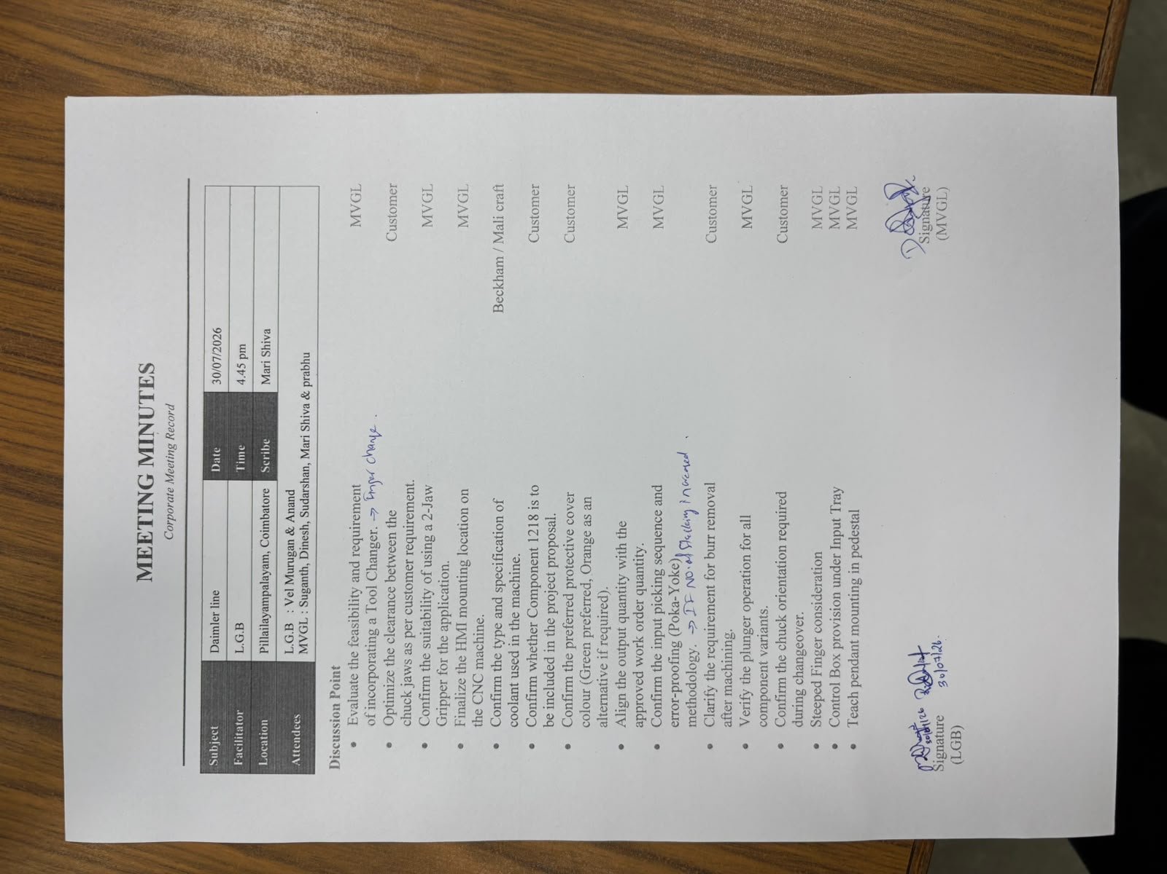
DAIMLER LINE DAP APPROVAL
LGB l Operations Technology

Slide 77
DAIMLER LINE
DAIMLER LINE TRACKER
S No. | Task Description | Planned Date | Actual Date | Status
1 | Requirement Date & Initial Feasibility | 30-Jun-25 | 30-Jun-25 | Closed
2 | Plant Input & Cycle Time Study | 03-Jul-25 | 10-Jul-25 | Closed
3 | Budgetary Estimation & RFQ | 25-Jul-25 | 20-Aug-25 | Closed
4 | Vendor Pre-Qualification & NDA | 09-Aug-25 | 04-Sep-25 | Closed
5 | RFQ Submission & Tech Discussion | 11-Aug-25 | 11-Sep-25 | Closed
6 | Vendor Site Evaluation | 10-Sep-25 | 05-Oct-25 | Closed
7 | Offer Evaluation & Tech Compliance | 15-Sep-25 | 18-Oct-25 | Closed
8 | Risk Assessment & Commercial Negotiation | 02-Oct-25 | 06-Dec-25 | Closed
9 | Techno-Commercial Comparison | 08-Oct-25 | 30-Jan-26 | Closed
10 | Vendor Finalization & Mgmt Approval | 12-Oct-25 | 16-Feb-26 | Closed
11 | Scope Freeze & PO Release | 02-Nov-25 | 21-Mar-26 | Closed
12 | Advance Payment & Design Kick-off | 30-Mar-26 | 03-Apr-26 | Closed
13 | Design Approval (Robotic + Gripper + Conveyor) | 15-Mar-26 | 04-Apr-26 | Closed
14 | Cobot Delivery | 17-Mar-26 | 15-May-26 | Closed
15 | Mechanical Fabrication (All Sub-systems) | 20-Mar-26 | 20-May-26 | Closed
16 | Electrical / Controls Build | 30-Mar-26 | 20-May-26 | Closed
17 | FAT | 25-May-26 | 05-Jun-26 | Closed
18 | Dispatch | 07-Jun-26 | 19-Jun-26 | Closed
19 | Installation & Commissioning | 13-Jun-26 | 23-Jul-26 | Closed
LGB l Operations Technology

Slide 78
STELLANTIS LINE 1 - PHASE
LGB l Operations Technology

Slide 79
PROJECT BOM - DAIMLER LINE
BOM | UOM | QTY | UNIT COST | TOTAL COST
Design & Engineering
PLC Program | Lot | 1 | ₹56,000 | ₹56,000
Project Management | Lot | 1 | ₹50,000 | ₹50,000
Drawing and Documentation | Lot | 1 | ₹2,04,000 | ₹2,04,000
Robots & AMR
UR12e | Nos | 4 | ₹17,00,000 | ₹68,00,000
Gripper & Fingure
Gripper | Nos | 8 | ₹55,100 | ₹5,51,000
Fingure | Nos | 8 | ₹1,76,000 | ₹1,76,000
Mechanical Accessories
Pedestal | Nos | 4 | ₹31,600 | ₹1,58,000
Input table & Other | Lot | 1 | ₹8,30,000 | ₹8,30,000
E&I
HMI , PLC | Lot | 1 | ₹3,90,000 | ₹3,90,000
Control Panel | Lot | 1 | ₹4,29,000 | ₹4,29,000
Installation & Commissioning | Lot | 1 | ₹2,74,000 | ₹2,74,000
Digitalization | Lot` | 1 | Inculaded in system price | Inculaded in system price
TOTAL |  |  |  | ₹1,00,00,000
LGB l Operations Technology

Slide 80
NO OF MANPOWER REDUCE - DAIMLER LINE
Manpower Reduction – DAIMLER LINE Automation
S.No | Part No. | Station / Operation | Manpower (Manual) / Per shift | Manpower (After Automation) / Per shift | Manpower Reduced / Per shift | Avg. Monthly Cost per Head (₹) / Per shift | Monthly Cost Savings (₹) / Per shift
1 | 1218 | OP10 Machine Operation | 2 | 1 | 3 | ₹22000 x 3 | ₹66000
 |  | OP20 Machine Operation
2 | 1217 | OP10 Machine Operation | 2
 |  | OP20 Machine Operation
3 | 1142 | OP10 Machine Operation | 2 | 1 | 3 | ₹22000 x 3 | ₹66000
 |  | OP20 Machine Operation
4 | 1386 | OP10 Machine Operation | 2
 |  | OP20 Machine Operation
TOTAL |  |  | 8 | 2 | 6 |  | ₹1,32,000
Summary | VALUE
Total Manpower Before (Manual) / Per shift | 8
Total Manpower After (Automation) / Per shift | 2
Total Manpower Reduced / Per shift | 6
% Manpower Reduction / Per shift | 70.5%
Total Monthly Cost Savings / Per shift | ₹1,32,000
Total Annual Cost Savings / Per shift | ₹15,84,000
LGB l Operations Technology

Slide 81
ROI CALCULATION - DAIMLER LINE
Parameter | Calculation | Value
Total Machines Automated |  | 08
Total Cobots Used |  | 4 UR12e
Operators Required per Shift (Current) |  | 08
Total Shifts per Day |  | 3
Total Operators Required per Day (Current) | 08 × 3 | 24
Salary per Operator per Month |  | ₹ 22,000
Current Monthly Manpower Cost | 24 × 22,000 | ₹ 5,28,000
Current Annual Manpower Cost | 5,28,000 × 12 | ₹ 63,36,000
Operators Required After Automation |  | 6
Monthly Manpower Cost After Automation | 6 × 22,000 | ₹ 1,32,000
Annual Manpower Cost After Automation | 1,32,000 × 12 | ₹ 15,84,000
Annual Savings Due to Automation | 63,36,000 − 15,84,000 | ₹ 47,52,000
Total Automation Project Cost |  | ₹ 1,00,00,000
ROI Payback Period (Years) | 1,00,00,000 ÷ 47,52,000 | 2.10 Years
ROI Payback Period (Months) | 2.10 × 12 | 25 Months
Operator Reduction | 08 − 02 | 06 Operators Reduced
Savings After 5 Years | (47,52,000 × 5) − 1,00,00,000 | ₹ 1,37,60,000
LGB l Operations Technology

Slide 82
CYCLE TIME CALCULATION — OP10 & OP20 - DAIMLER LINE
Part No | OP10 & OP20 output/hr | OP10 & OP20 output/shift | OP10 & OP20 output/day | OP10 & OP20 Production actual/ month(nos) | OP10 & OP20 efficiency | OP10 & OP20 Production requirement/ month(nos) | OP10 & OP20 cnc machine | OP10 & OP20 cobot
1217 | 25 | 188 | 563 | 14625 | 85% | 15000 | 2 | 1
1218 | 21 | 158 | 473 | 12285 | 85% | 15000 | 2 | 1
1361 | 31 | 233 | 698 | 18135 | 85% | 25000 | 2 | 1
1142 | 19 | 143 | 428 | 11115 | 85% | 15000 | 2 | 1
LGB l Operations Technology

Slide 83
PO DETAILS - DAIMLER LINE
INVOICING PLAN – STELLANTIS ROBOTIC LINE PROJECT
S No. | Milestone Payment % | Milestone Payment Description | Amount (₹) | Planned Invoice Date | Actual Invoice Date | Invoice No. | Payment Status | Remark
1 | 50% | Advance to Supplier | ₹50,00,000 | 01-Jul-2026 (PO date) |  |  | Pending | Advance paid
2 | 40% | Upon Delivery at Site | ₹40,00,000 | 20-Oct -2026 |  |  | Pending | Delivary at Site
3 | 10% | Upon Installation & Commissioning | ₹10,00,000 | 10-Nov-2026 |  |  | Pending | Installation & Commissioning
Total | 100% |  | ₹1,00,00,000
LGB l Operations Technology

Slide 84
ACTIVITY IMPLEMENTATION STATUS - DAIMLER LINE
ATHER LINE ACTIVITY CHART
 | Jul |  |  |  | Aug |  |  |  | Sep |  |  |  | Oct |  |  |  | Nov |  |  |  | Dec
Week | 1 | 2 | 3 | 4 | 5 | 6 | 7 | 8 | 9 | 10 | 11 | 12 | 13 | 14 | 15 | 16 | 17 | 18 | 19 | 20 | 21 | 22 | 23 | 24
Receipt of Purchase order / LOI |  |  | x | x
Detailed layout , Drawing and BOQ submission for Approval |  |  |  | x | x | x | x
Manufacturing - Mechanical |  |  |  |  |  |  | x | x | x | x | x | x | x | x
Manufacturing - Electrical |  |  |  |  |  | x | x | x | x | x | x | x | x | x
Assembly - Mechanical |  |  |  |  |  |  |  |  | x | x | x | x | x | x | x | x
Assembly - Electrical (including Panel interface) |  |  |  |  |  |  |  | x | x | x | x | x | x | x | x | x
Internal Trials (no load test) |  |  |  |  |  |  |  |  |  |  |  |  | x | x | x | x
FAT Test |  |  |  |  |  |  |  |  |  |  |  |  |  |  |  |  | x | x
I&C |  |  |  |  |  |  |  |  |  |  |  |  |  |  |  |  |  |  | x | x | x | x | x
Current status - MD approval
LGB l Operations Technology

Slide 85
06
Vallam Machine Tending

Slide 86
DAIMLER LINE
3D Isometric Layout
LGB l Operations Technology

Slide 87
DAIMLER LINE
2D Floor Layout
1217
1218
1142
1361
No. of Cobots – 4 nos.
No. of Input Table – 4 nos.
No. of Output Table – 4 nos.
LGB l Operations Technology

Slide 88
PROJECT BOM - DAIMLER LINE
BOM | UOM | QTY | UNIT COST | TOTAL COST
Design & Engineering
PLC Program | Lot | 1 | ₹56,000 | ₹56,000
Project Management | Lot | 1 | ₹50,000 | ₹50,000
Drawing and Documentation | Lot | 1 | ₹2,04,000 | ₹2,04,000
Robots & AMR
UR12e | Nos | 4 | ₹17,00,000 | ₹68,00,000
Gripper & Fingure
Gripper | Nos | 8 | ₹55,100 | ₹5,51,000
Fingure | Nos | 8 | ₹1,76,000 | ₹1,76,000
Mechanical Accessories
Pedestal | Nos | 4 | ₹31,600 | ₹1,58,000
Input table & Other | Lot | 1 | ₹8,30,000 | ₹8,30,000
E&I
HMI , PLC | Lot | 1 | ₹3,90,000 | ₹3,90,000
Control Panel | Lot | 1 | ₹4,29,000 | ₹4,29,000
Installation & Commissioning | Lot | 1 | ₹2,74,000 | ₹2,74,000
Digitalization | Lot` | 1 | Inculaded in system price | Inculaded in system price
TOTAL |  |  |  | ₹1,00,00,000
LGB l Operations Technology

Slide 89
NO OF MANPOWER REDUCE - DAIMLER LINE
Manpower Reduction – DAIMLER LINE Automation
S.No | Part No. | Station / Operation | Manpower (Manual) / Per shift | Manpower (After Automation) / Per shift | Manpower Reduced / Per shift | Avg. Monthly Cost per Head (₹) / Per shift | Monthly Cost Savings (₹) / Per shift
1 | 1218 | OP10 Machine Operation | 2 | 1 | 3 | ₹22000 x 3 | ₹66000
 |  | OP20 Machine Operation
2 | 1217 | OP10 Machine Operation | 2
 |  | OP20 Machine Operation
3 | 1142 | OP10 Machine Operation | 2 | 1 | 3 | ₹22000 x 3 | ₹66000
 |  | OP20 Machine Operation
4 | 1386 | OP10 Machine Operation | 2
 |  | OP20 Machine Operation
TOTAL |  |  | 8 | 2 | 6 |  | ₹1,32,000
Summary | VALUE
Total Manpower Before (Manual) / Per shift | 8
Total Manpower After (Automation) / Per shift | 2
Total Manpower Reduced / Per shift | 6
% Manpower Reduction / Per shift | 70.5%
Total Monthly Cost Savings / Per shift | ₹1,32,000
Total Annual Cost Savings / Per shift | ₹15,84,000
LGB l Operations Technology

Slide 90
PO DETAILS - DAIMLER LINE
LGB l Operations Technology

Slide 91
ROI CALCULATION - DAIMLER LINE
Parameter | Calculation | Value
Total Machines Automated |  | 08
Total Cobots Used |  | 4 UR12e
Operators Required per Shift (Current) |  | 08
Total Shifts per Day |  | 3
Total Operators Required per Day (Current) | 08 × 3 | 24
Salary per Operator per Month |  | ₹ 22,000
Current Monthly Manpower Cost | 24 × 22,000 | ₹ 5,28,000
Current Annual Manpower Cost | 5,28,000 × 12 | ₹ 63,36,000
Operators Required After Automation |  | 6
Monthly Manpower Cost After Automation | 6 × 22,000 | ₹ 1,32,000
Annual Manpower Cost After Automation | 1,32,000 × 12 | ₹ 15,84,000
Annual Savings Due to Automation | 63,36,000 − 15,84,000 | ₹ 47,52,000
Total Automation Project Cost |  | ₹ 1,00,00,000
ROI Payback Period (Years) | 1,00,00,000 ÷ 47,52,000 | 2.10 Years
ROI Payback Period (Months) | 2.10 × 12 | 25 Months
Operator Reduction | 08 − 02 | 06 Operators Reduced
Savings After 5 Years | (47,52,000 × 5) − 1,00,00,000 | ₹ 1,37,60,000
LGB l Operations Technology

Slide 92
CYCLE TIME CALCULATION — OP10 & OP20 - DAIMLER LINE
Part No | OP10 & OP20 output/hr | OP10 & OP20 output/shift | OP10 & OP20 output/day | OP10 & OP20 Production actual/ month(nos) | OP10 & OP20 efficiency | OP10 & OP20 Production requirement/ month(nos) | OP10 & OP20 cnc machine | OP10 & OP20 cobot
1217 | 25 | 188 | 563 | 14625 | 85% | 15000 | 2 | 1
1218 | 21 | 158 | 473 | 12285 | 85% | 15000 | 2 | 1
1361 | 31 | 233 | 698 | 18135 | 85% | 25000 | 2 | 1
1142 | 19 | 143 | 428 | 11115 | 85% | 15000 | 2 | 1
LGB l Operations Technology

Slide 93
ACTIVITY IMPLEMENTATION STATUS - DAIMLER LINE
ATHER LINE ACTIVITY CHART
 | Jul |  |  |  | Aug |  |  |  | Sep |  |  |  | Oct |  |  |  | Nov |  |  |  | Dec
Week | 1 | 2 | 3 | 4 | 5 | 6 | 7 | 8 | 9 | 10 | 11 | 12 | 13 | 14 | 15 | 16 | 17 | 18 | 19 | 20 | 21 | 22 | 23 | 24
Receipt of Purchase order / LOI |  |  | x | x
Detailed layout , Drawing and BOQ submission for Approval |  |  |  | x | x | x | x
Manufacturing - Mechanical |  |  |  |  |  |  | x | x | x | x | x | x | x | x
Manufacturing - Electrical |  |  |  |  |  | x | x | x | x | x | x | x | x | x
Assembly - Mechanical |  |  |  |  |  |  |  |  | x | x | x | x | x | x | x | x
Assembly - Electrical (including Panel interface) |  |  |  |  |  |  |  | x | x | x | x | x | x | x | x | x
Internal Trials (no load test) |  |  |  |  |  |  |  |  |  |  |  |  | x | x | x | x
FAT Test |  |  |  |  |  |  |  |  |  |  |  |  |  |  |  |  | x | x
I&C |  |  |  |  |  |  |  |  |  |  |  |  |  |  |  |  |  |  | x | x | x | x | x
LGB l Operations Technology

Slide 94
EXECUTIVE SUMMERY
05
18+
1
2
2
OEM LINES IN EXECUTION
ROBOTS & COBOTS DEPLOYED
IN INSTALLATION & COMMISSIONING
IN DESIGN APPROVAL (DAP)
AWAITING PR
LGB l Operations Technology

Slide 95
Thank You

